Slide 1
Seating Excellence since 1928
This presentation is confidential and is intended only for the individual named. Disclosing, copying, distributing or taking any action in reliance on the contents of this information is strictly prohibited

Slide 2
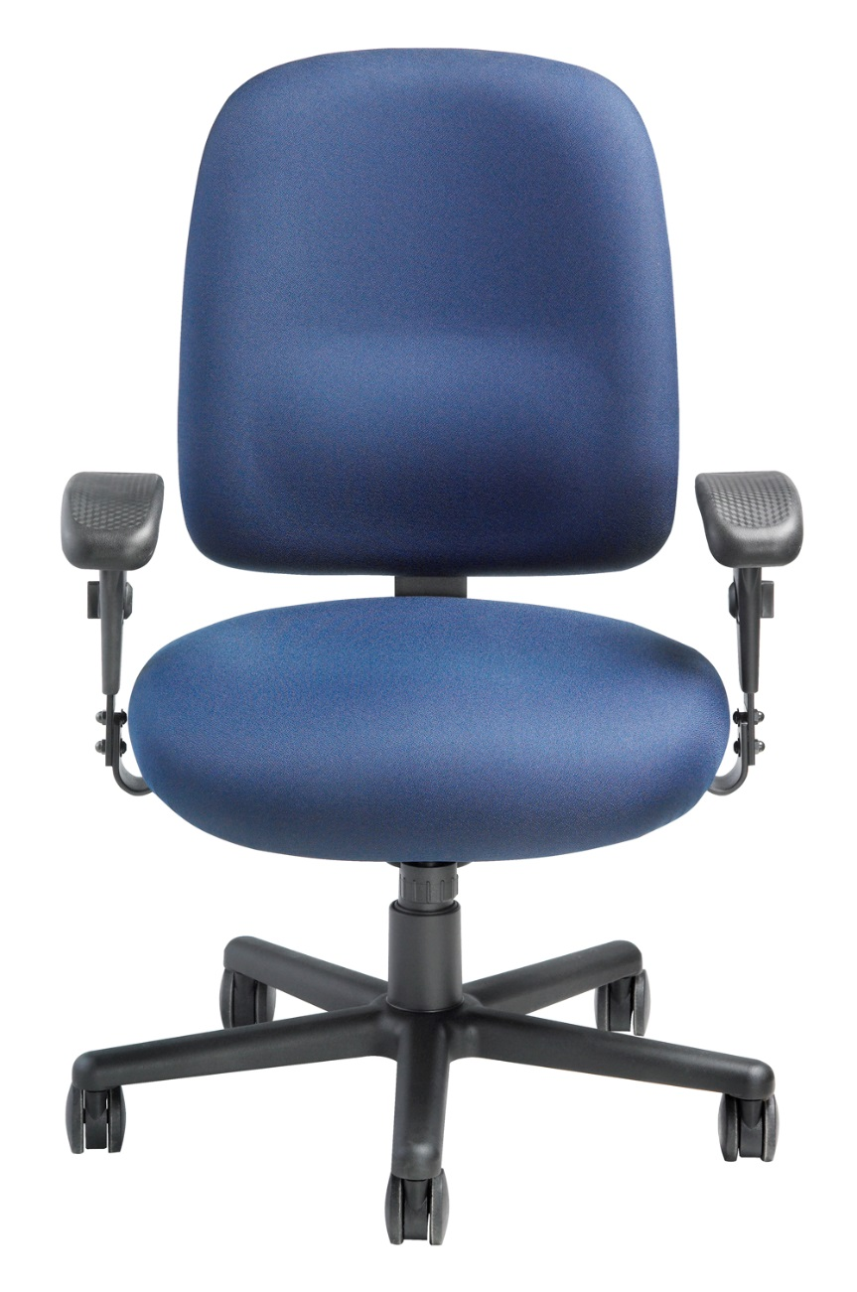
Seating that Won’t
Tank under Stress
HD9000 Sherman
Heavy Duty Task Chair w/Fold Away Arms
Supports 450 lbs capacity
3 shifts a day: 24/7 usage

Slide 3
Swivel Mechanism
Pneumatic height adjustment
2.5" seat depth
adjustment
Built in lumbar support
Reinforced steel seat
and back bar

Slide 4
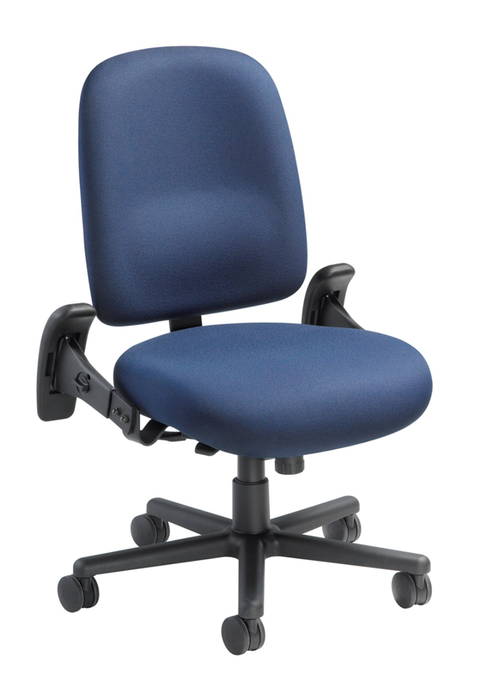
Oversized molded foam seat pan with a waterfall
edge for greater comfort and to promote proper
circulation
Heavy duty steel fold away arms that are height
and width adjustable with ultra comfortable
polyurethane arm pads

Slide 5
28" 5 leg, structurally engineered aluminum base
available with 3" casters
or floor glides

Slide 6
Options
Armless
3" Soft Tile Casters
California Fire Code #133

Slide 7
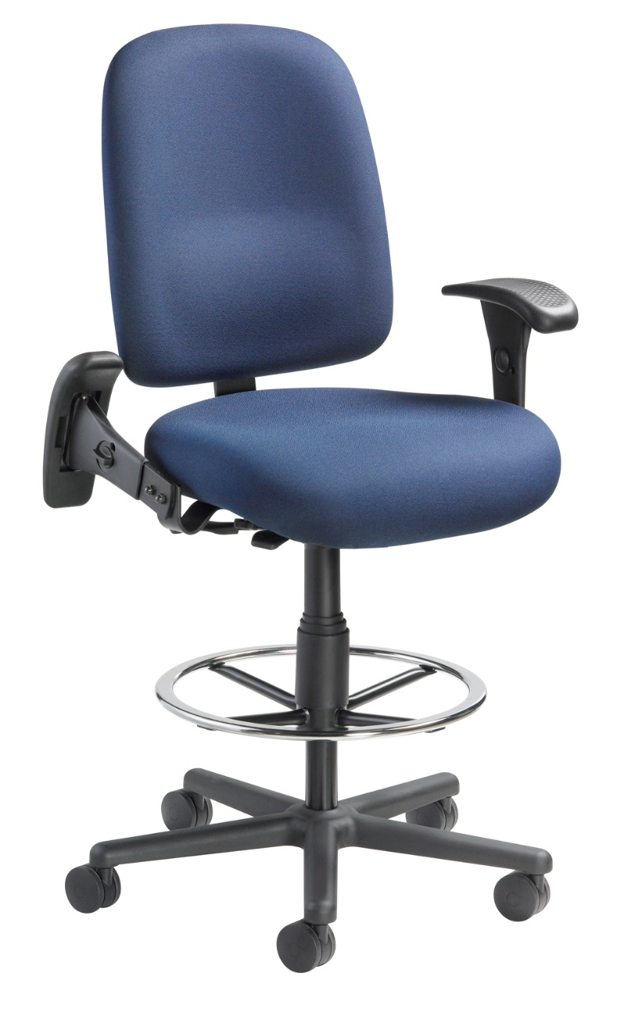
HD9000DS Sherman
Heavy Duty Drafting Stool w/Fold Away Arms
Supports 350 lbs capacity
3 shifts a day: 24/7 usage
Heavy duty height adjustable foot ring
Heavy duty support at
drafting stool height
All Day . Every Day

Slide 8
HD9000 & HD9000DS Weight Usage Comparison
HD9000
Task Chair
Supports 450 lbs capacity
3 shifts a day: 24/7 usage
HD9000DS
Drafting Stool
Supports 350 lbs capacity
3 shifts a day: 24/7 usage

Slide 9
Applications
Multi Shift Operations
Law Enforcement
911 Call Center
Fire Halls
Security
Laboratory
Factory
Community Center

Slide 10
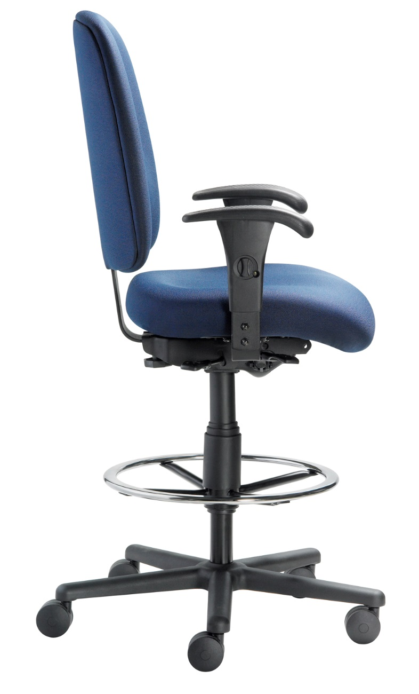
Level 1 e3 Certified
GREENGUARD Children & School and Indoor Air Quality Certified
Nightingale is a 100% waste
free facility; powered by
Solar & Wind

Slide 11
Rating & Warranty
HD9000
450 lbs capacity
3 shifts a day: 24/7 usage
HD9000DS
350 lbs capacity
3 shifts a day: 24/7 usage
Lifetime Limited:
All non-moving metal parts
5 Years: Frame & Parts
2 Years: Upholsteries

Slide 12
Any Questions ?

Slide 13
Mark Francis
Learning & Development Manager
Nightingale University
905.896.3434
800.363.8954
Ext 204
mfrancis@nightingalechairs.com
www.nightingalechairs.com

