Slide 1
Seating Excellence since 1928
This presentation is confidential and is intended only for the individual named. Disclosing, copying, distributing or taking any action in reliance on the contents of this information is strictly prohibited

Slide 2
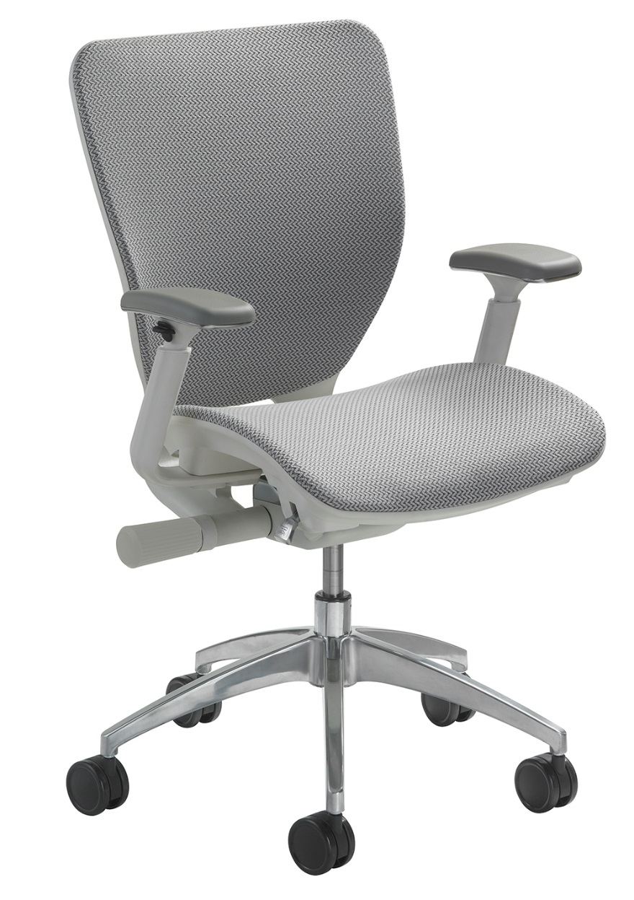
Automatic Attitude Adjustment
Adjusts how you feel
at work
Adjusts how you feel
about work
A perfect working chair

Slide 3
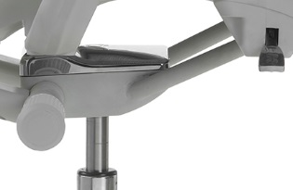
A Broad Range of Adjustability
TORGLIDER™
Synchronous, balanced
free float torsion glide swivel mechanism
Locks in two
positions
Cable activated
controls

Slide 4
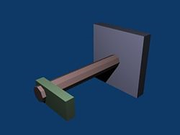
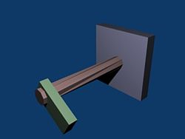
Torsion Bar
A torsion bar works by resisting the torque that is placed on it. When one end of the torsion bar is attached to an object that cannot be moved, the other end of the bar is twisted, causing torque to build up
A torsion bar is far superior to a ‘spring system’ that loses strength over time and is inconsistent, and uneven, in tension/torque. The bar also has no moving parts to wear out
Torsion Bar : No Load
Torsion Bar : With Load

Slide 5
Torsion Bar
Results
Sitting experience is enhanced by constant, precise and accurate back support throughout the full recline range; realized from consistent tension/torque offered by the torsion bar

Slide 6
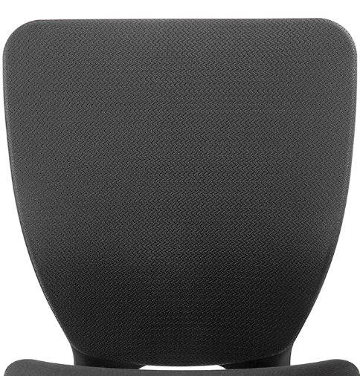
Back
ABLEX™ dual mesh backing allows air to pass freely,
making it comfortable in
all environments
It also boasts
dynamic movement …
in other words, it
moves with you

Slide 7
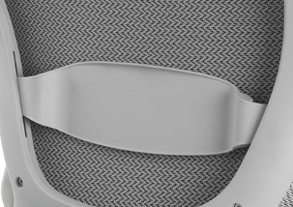
Lumbar Support
The contoured polyurethane lumbar support pad, with easy vertical adjustment, provides the user the
exact support needed
for a comfortable sitting experience

Slide 8
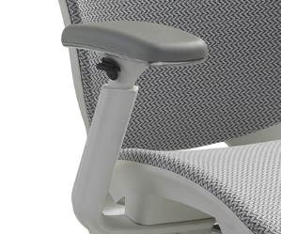
3D Armrests
Height and width adjustable with lockable swivel adjustment
Polyurethane arm
pad for durability

Slide 9
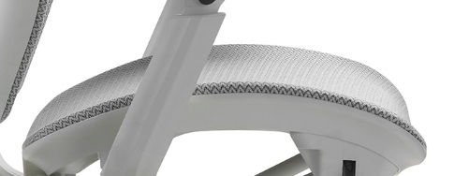
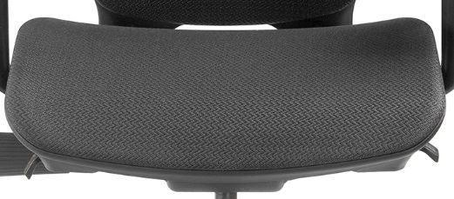
Seat
Fabric or mesh seat; incorporating a “waterfall”
design that gently slopes away from the legs, minimizing pressure
on the thighs
Fabric seat consists of
ENERSORB™ cushioning, allowing for greater blood circulation which reduces seating pressure points
Mesh seat offers ABLEX mesh, with dynamic adaptability and movement

Slide 10
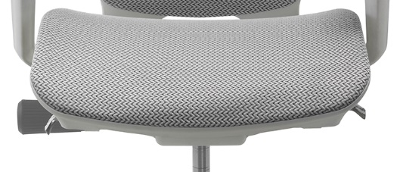
Side tension control for personalized seat and
back support
Right side lever for
pneumatic height
Left side lever for
two position lock or
free float

Slide 11
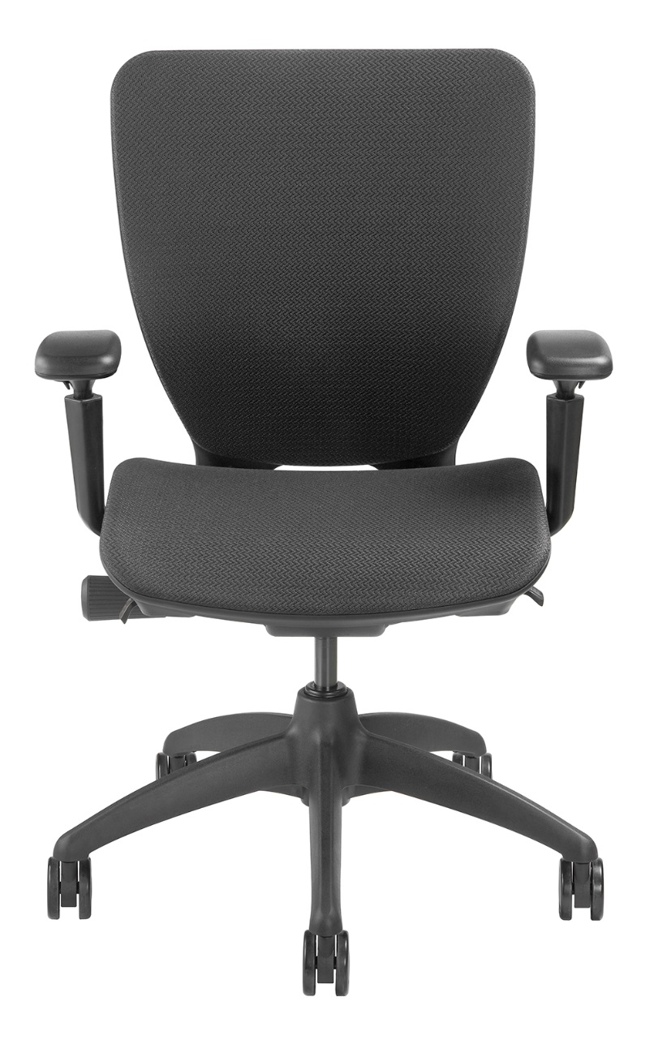
Options
White Frame (Standard with silver mesh and polished aluminum base)
Soft Wheel Casters 2“
Polished Aluminum Base
Larger Wheel Carpet Casters 3“
California Fire Code #133

Slide 12
Applications
Task
Boardroom
Standards
Ergonomic
Assessment
Multi User
TORGLIDER™

Slide 13
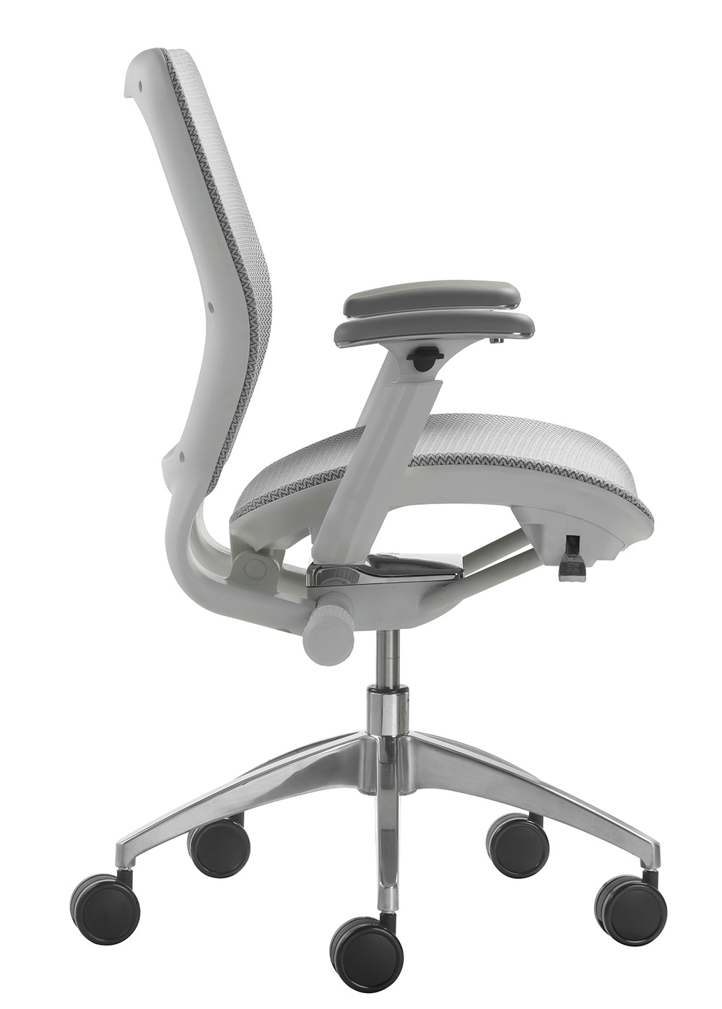
Level 1 e3 Certified
GREENGUARD Children & School and Indoor Air Quality Certified
Nightingale is a 100% waste
free facility; powered by
Solar & Wind

Slide 14
Rating & Warranty
Rated for users up to 300 pounds, for a 40 hour work week
Lifetime Limited: All non-moving metal parts.
10 Years: Frame & Parts
5 Years: Upholsteries

Slide 15
Any Questions ?

Slide 16
Mark Francis
Learning & Development Manager
Nightingale University
905.896.3434
800.363.8954
Ext 204
mfrancis@nightingalechairs.com
www.nightingalechairs.com

