Slide 1
Seating Excellence since 1928
This presentation is confidential and is intended only for the individual named. Disclosing, copying, distributing or taking any action in reliance on the contents of this information is strictly prohibited

Slide 2
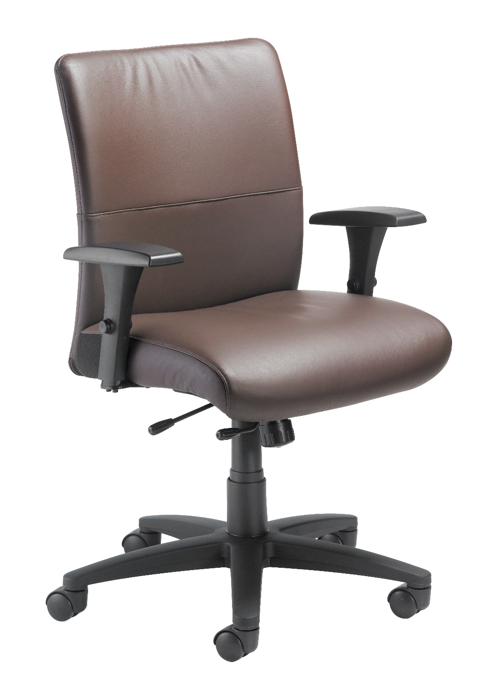
Dress for Success
Brings an immediate sophisticated and clean
look to any meeting or conference room

Slide 3
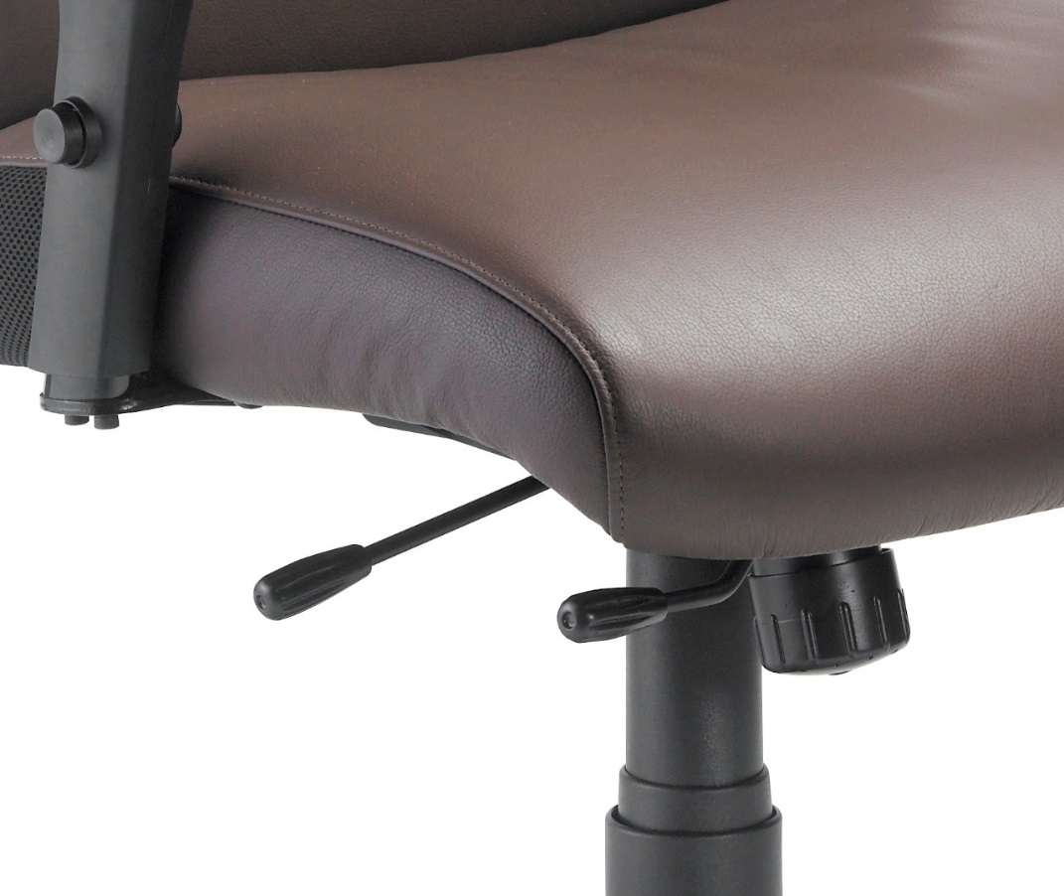
Mechanism
Synchronous Tilt
Mech
Tilt Lock
Pneumatic Lift
Tension Control

Slide 4
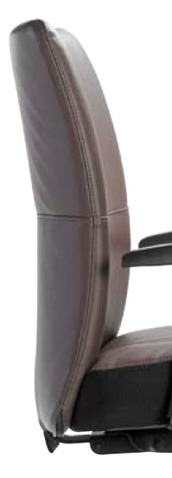
Back
Contoured back for
added lateral back
support
ENERSORB™ cushioning

Slide 5
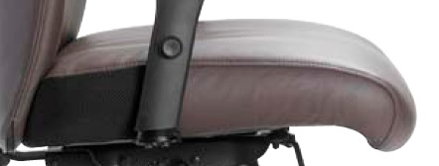
Seat
Waterfall front
Breathable mesh at back of
seat allows for air release
related to leather cover
2” ENERSORB™
absorbs and conforms to the weight and shape of the user, dispersing weight not only vertically, but horizontally as well; dramatically reducing potential for sitting fatigue

Slide 6
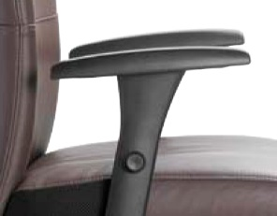
Arm
Height adjustable
with polyurethane
arm pads

Slide 7
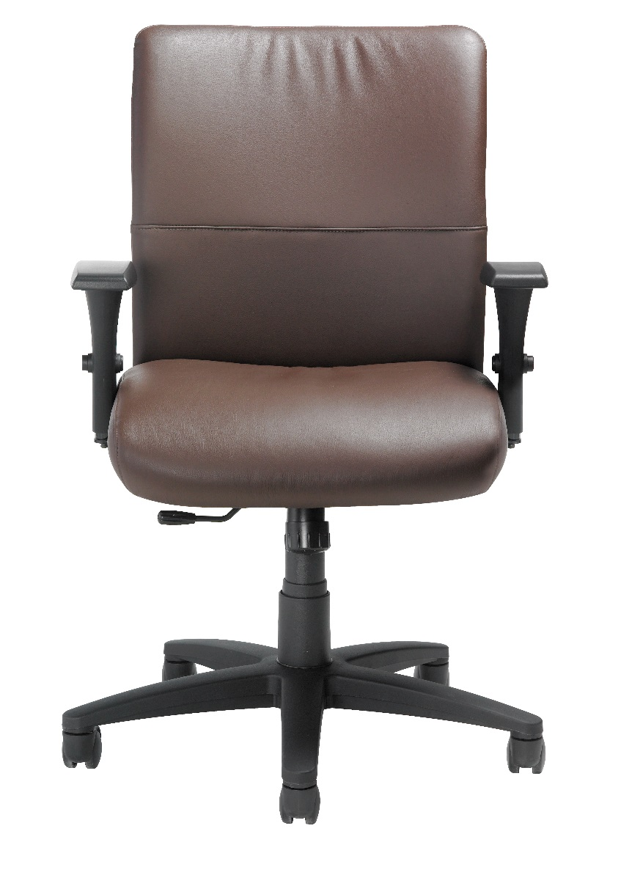
Leather Plus
Standard / Madras
Princess
Always Italian
Vinyl or Full Leather Upholstery
* NOTE: A pillow upholstery technique is used with vinyl, leather
or leather plus to provide a wrinkled, plush appearance

Slide 8
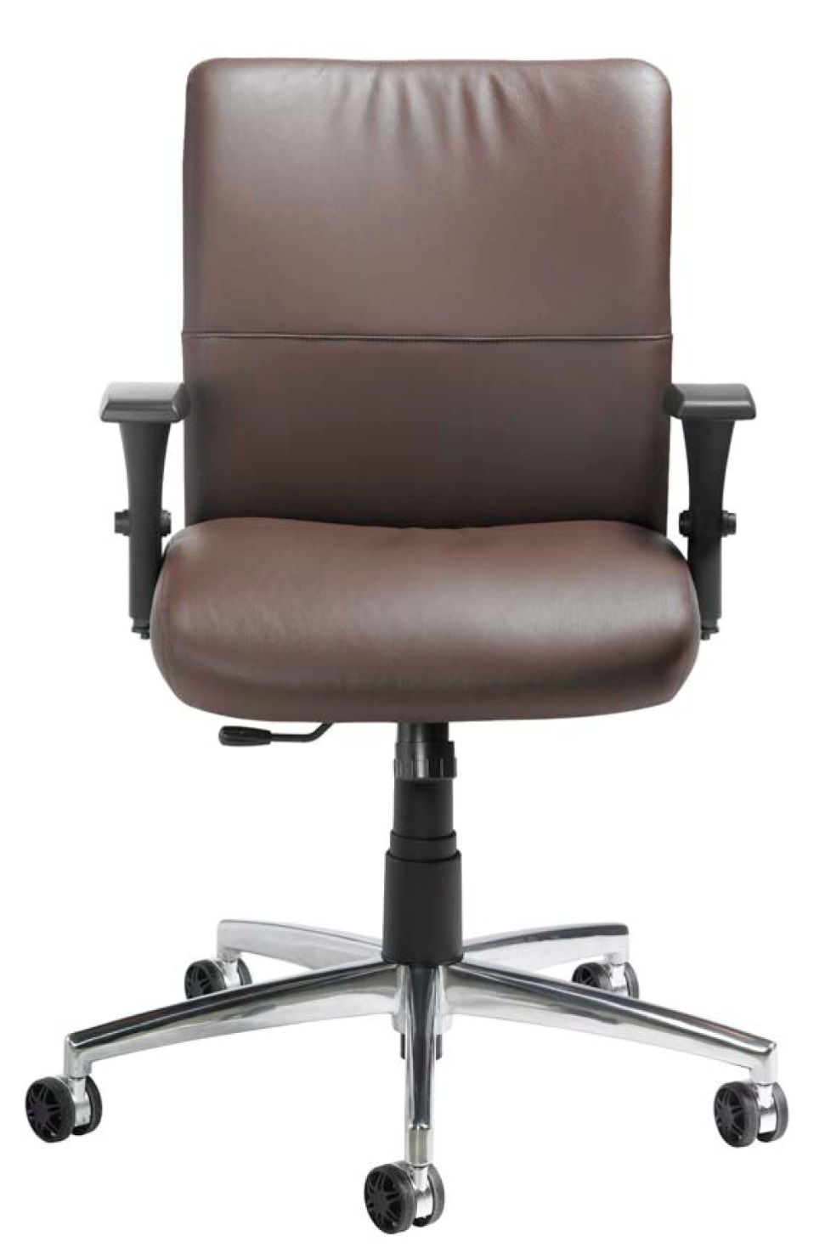
Options
Available with,
or without, arms
Polished aluminum base
California Fire Code #133
Soft Tile Casters 2”
Auto-Return Gas Lift
[seat height range 16"-18½“]
3" Carpet Casters

Slide 9
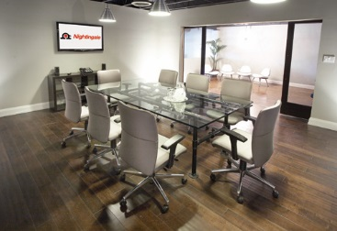
Applications
Executive:
Lawyers & Accountants
Boardroom
Steelcase Jacket

Slide 10
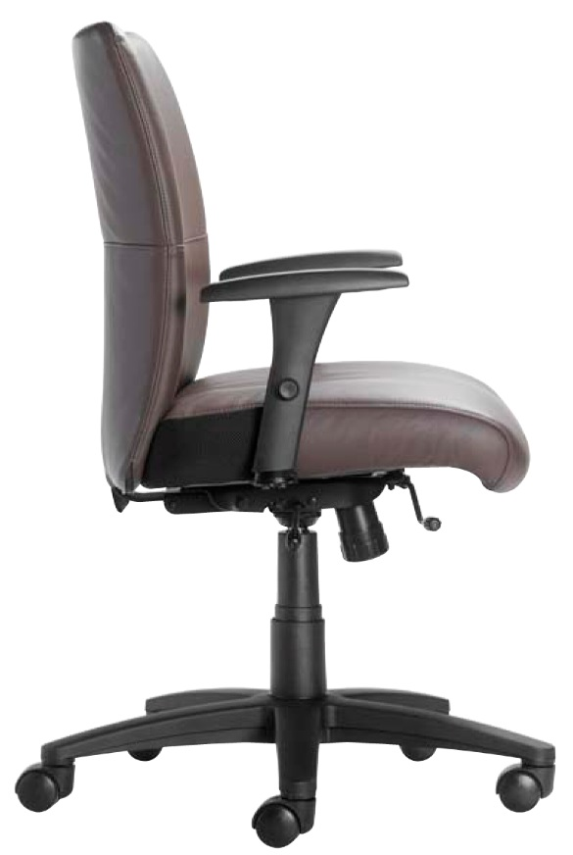
Level 1 e3 Certified
GREENGUARD Children & School and Indoor Air Quality Certified
Nightingale is a 100% waste free facility; powered by Solar & Wind

Slide 11
Rating & Warranty
Rated for users up to 300 pounds, for a 40 hour work week
Lifetime Limited: All non-moving metal parts.
10 Years: Frame & Parts
5 Years: Upholsteries

Slide 12
Any Questions ?

Slide 13
Mark Francis
Learning & Development Manager
Nightingale University
905.896.3434
800.363.8954
Ext 204
mfrancis@nightingalechairs.com
www.nightingalechairs.com

