Slide 1
Seating Excellence since 1928
This presentation is confidential and is intended only for the individual named. Disclosing, copying, distributing or taking any action in reliance on the contents of this information is strictly prohibited

Slide 2
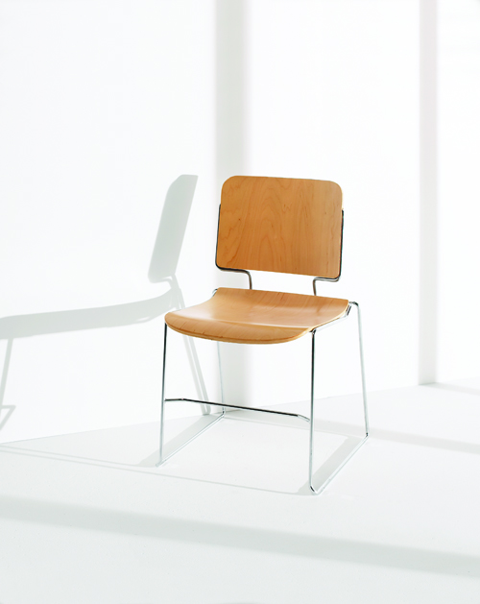
This is How We Stack up Against the Competition
Comfortable, supportive seating solution ideal for educational, institutional, mass seating or
occasional use

Slide 3
Applications
Mass Seating
Cafeterias
Class Rooms
Trade Shows
Convention Halls

Slide 4
Standard
16 gauge solid steel bar frame construction for strength and durability
Frame cross bar setback to provide greater leg clearance
Standard with hard maple veneer and with clear lacquer finish (309 model)

Slide 5
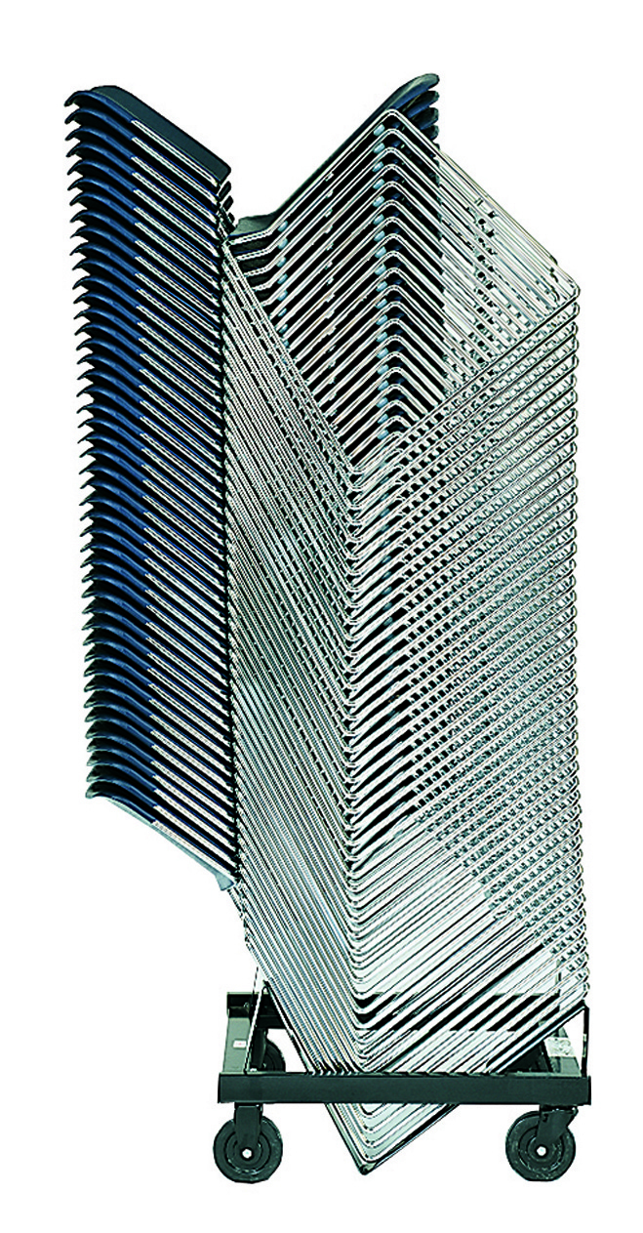
Standard
Conveniently stacks 45 high on a dolly while easily passing through
a 79” doorway
Upholstered models stack 26 high on a dolly and come complete with separators to prevent
damage to fabric and foam
Available in 6 standard colors: Burgundy, Chocolate, Regimental Blue, Warm Gray, Black and White

Slide 6
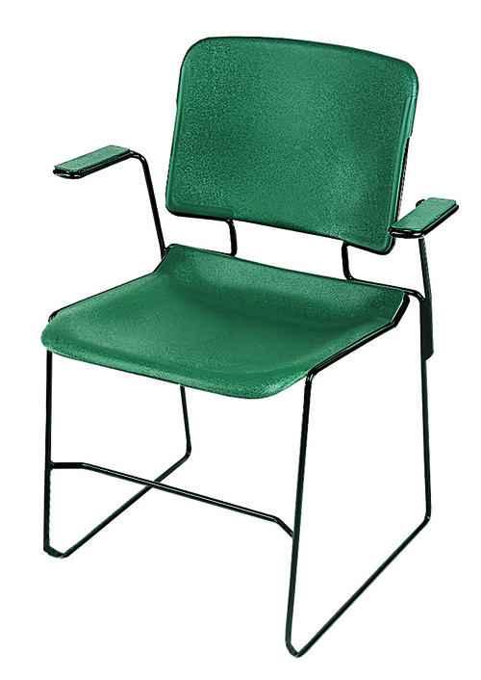
Standard
Standard frame notched to accept optional floor glides
Textured and contoured polypropylene seat and back shells are contoured by design for ergonomic comfort
Model 301, with arms, standard with color matching polypropylene arm pads
Finish for 300AT tablet arm is standard in black laminate with
solid hardwood core
ANSI / BIFMA

Slide 7
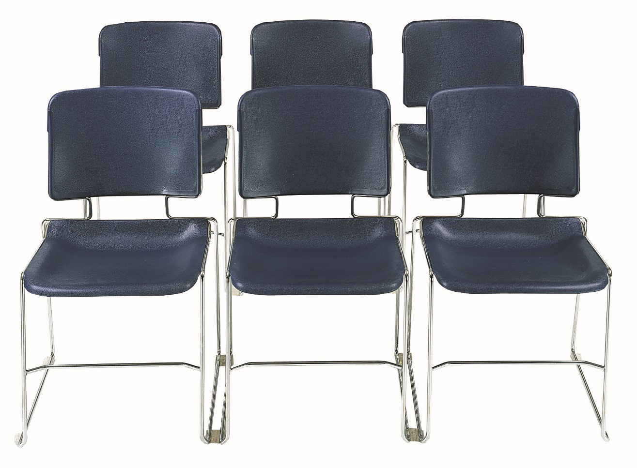
Options
Upholstered Seat & Back
Wire Basket
Ganging Glide
Hard Plastic Glide
Soft Plastic Glide
Welded Ganging
Wire Hook
30D Dolly

Slide 8
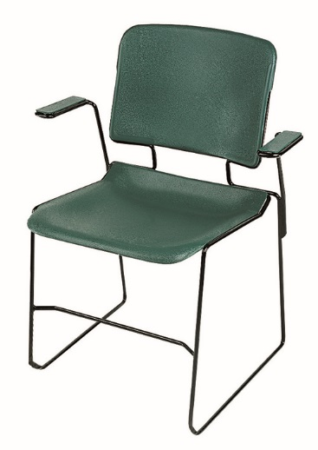
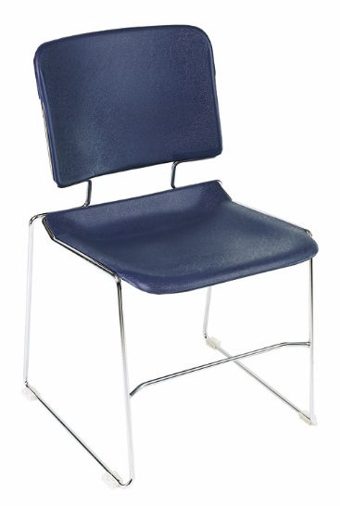
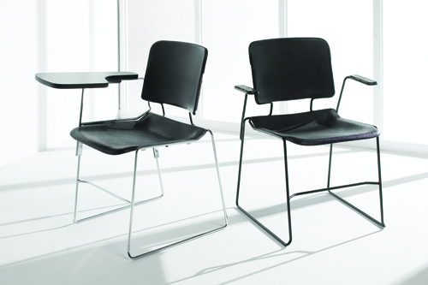
309 Natural Wood
Stacker Armless
300AT Side Chair with Tablet Arm
308 High Density
Stacker Armless
301 High Density
Stacker with Arms

Slide 9
Rating & Warranty
Rated for users up to 300 pounds, for a 40 hour work week
Lifetime Limited: All non-moving metal parts.
10 Years: Frame & Parts
5 Years: Upholsteries

Slide 10
Level 1 e3 Certified
GREENGUARD Children & School and Indoor Air Quality Certified
Nightingale is a 100% waste
free facility; powered by
Solar & Wind

Slide 11
Mark Francis
Learning & Development Manager
Nightingale University
905.896.3434
800.363.8954
Ext 204
mfrancis@nightingalechairs.com
www.nightingalechairs.com

