Slide 1
Seating Excellence since 1928
This presentation is confidential and is intended only for the individual named. Disclosing, copying, distributing or taking any action in reliance on the contents of this information is strictly prohibited

Slide 2
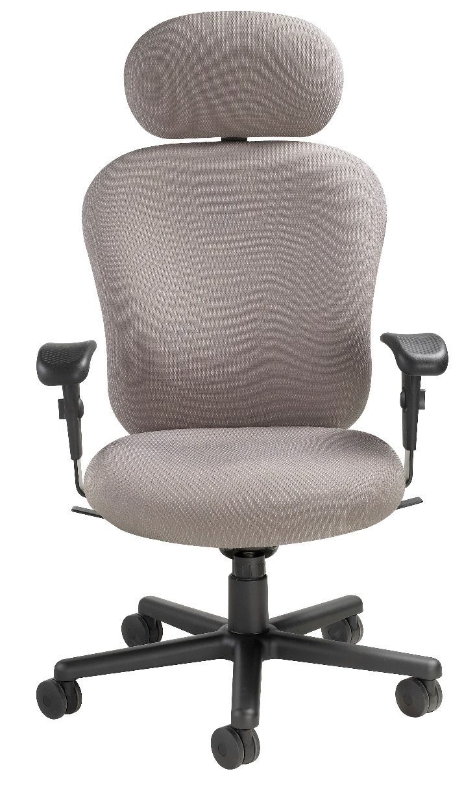
Maximum Comfort
Abundant Style
Ultimate Support
Supports 450 lbs capacity
3 shifts a day: 24/7 usage

Slide 3
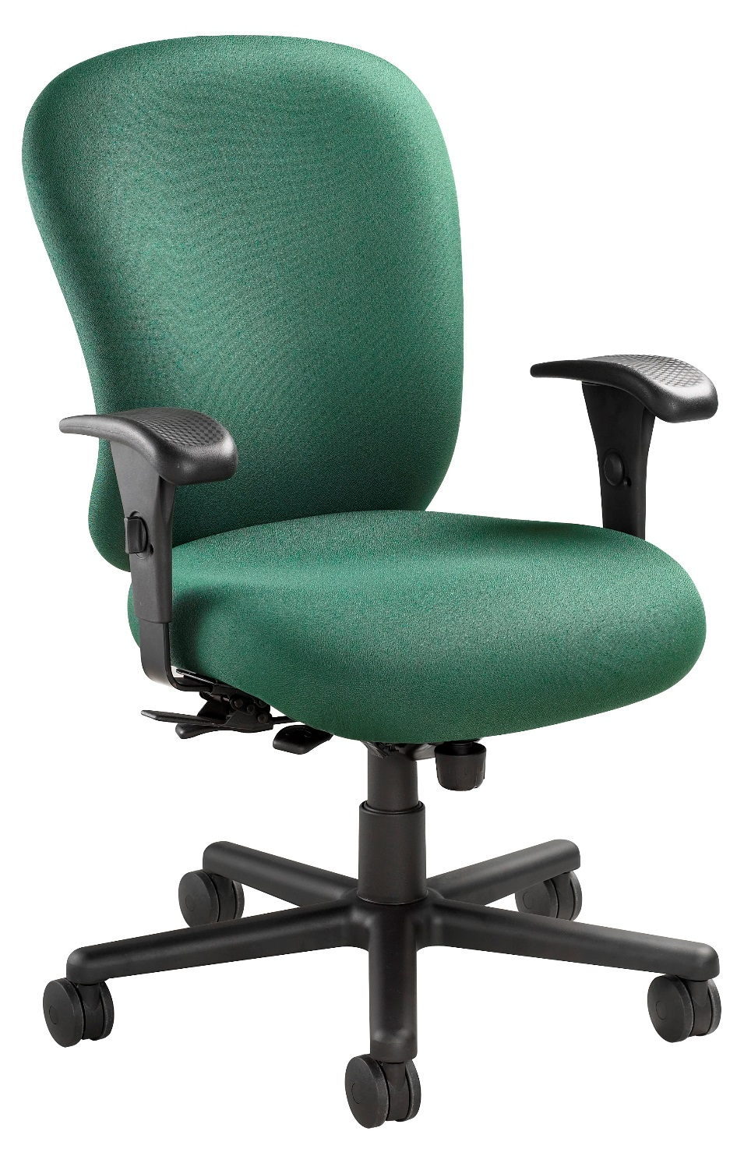
Swivel-Tilt Mechanism
Infinite Position
Tilt Lock
Back Seat Depth Adjustment
Pneumatic Height Adjustment
Tension Control

Slide 4
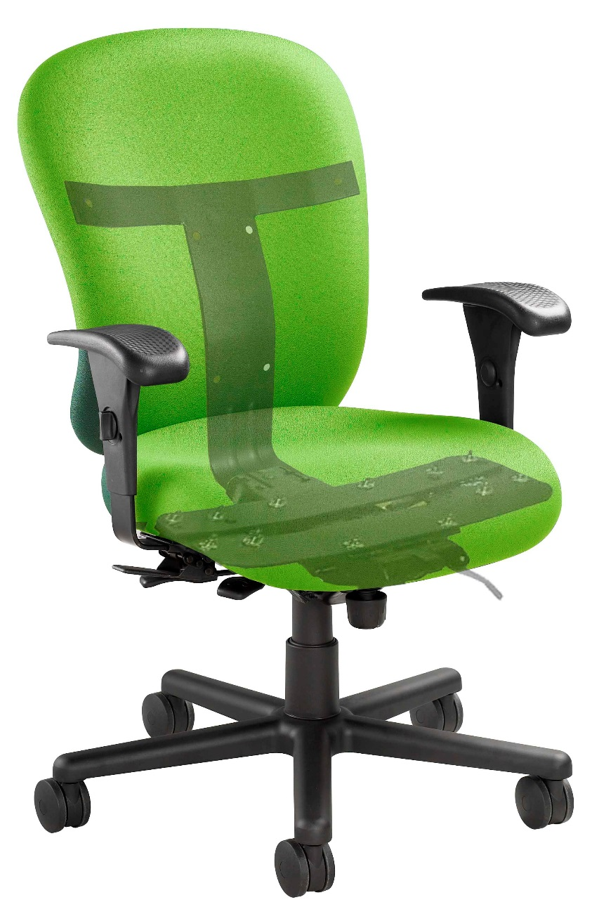
It’s What’s Inside
that Matters
Vertical ¼" thick steel plate
running from front of seat to
mid-back, is crimped for
even extra strength
2 steel plates run side-to-side at seat front; supporting areas of increased stress
Back steel plate runs side-to-side; offering needed strength during back movement of user

Slide 5
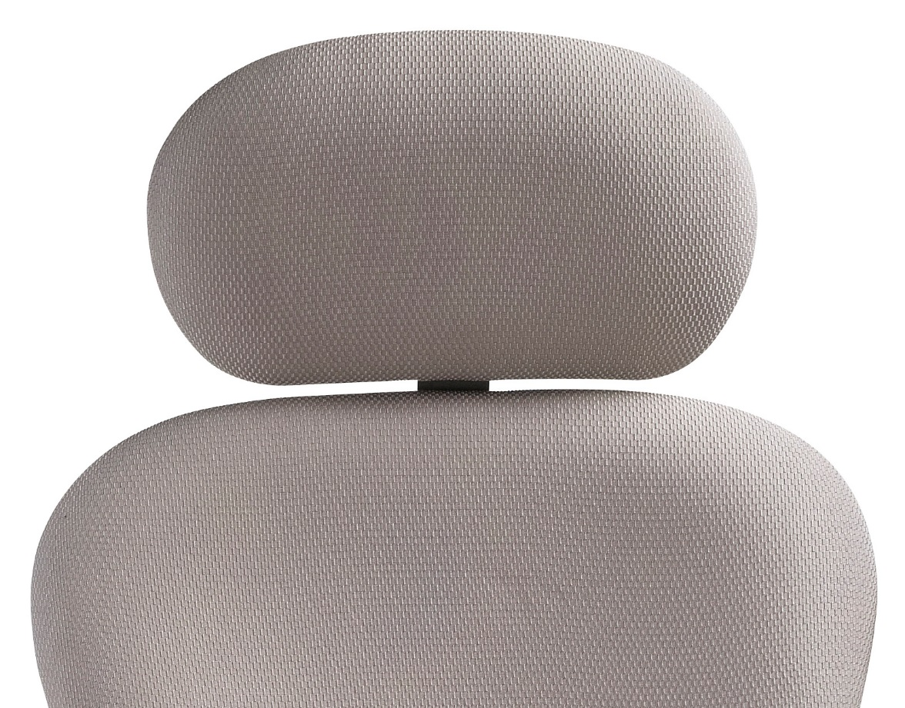
Ratchet Headrest

Slide 6
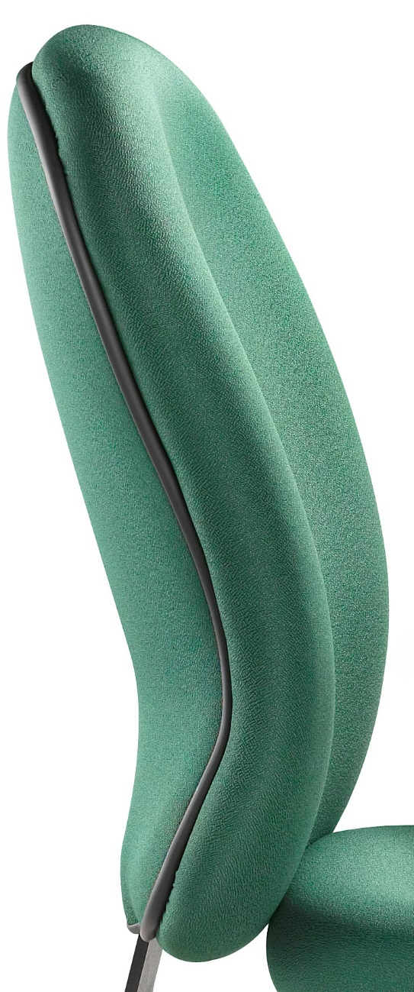
Built-in lumbar
back support
Compound curved back provides user with ergonomic support
and comfort
Improves performance by encouraging proper posture

Slide 7
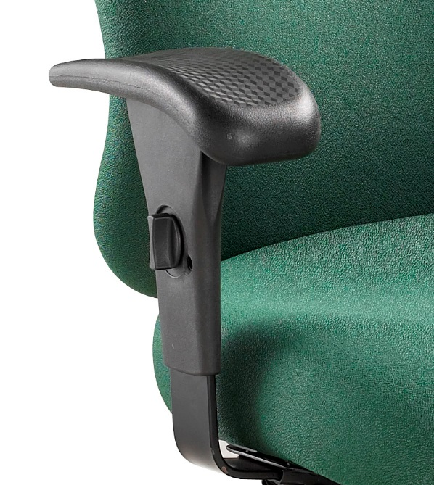
Lever operated width and height adjustable arms
Polyurethane waterfall
arm pad offering both comfort and durability

Slide 8
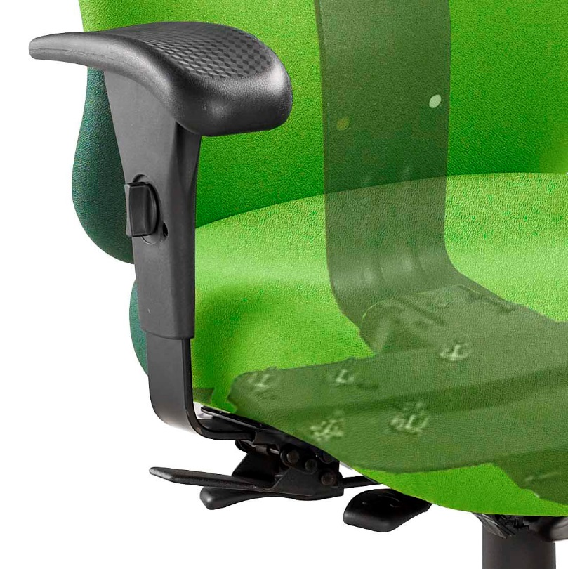
Attached to frame;
not seat pan
Arm pad reinforced
with a steel plate
This fully supports a larger user as they hold the arm pad to assist with their enter/exit of the 24/7

Slide 9
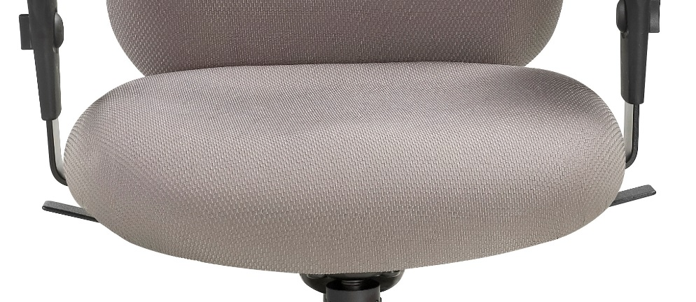
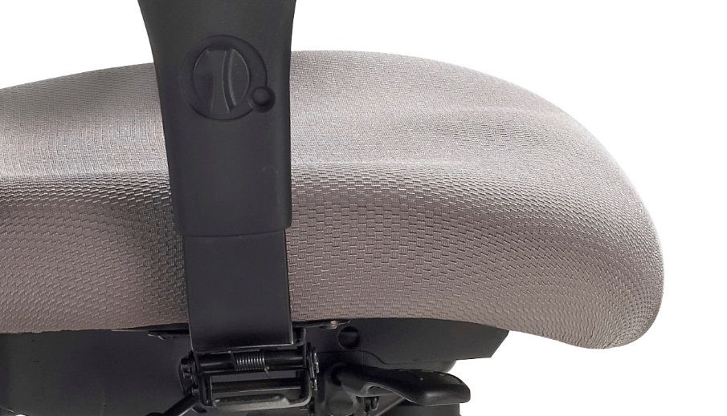
Thick 3" high density and high resilience seat cushioning with
ENERSORB™ top provides support all day long
Waterfall seat design to reduce muscle fatigue

Slide 10
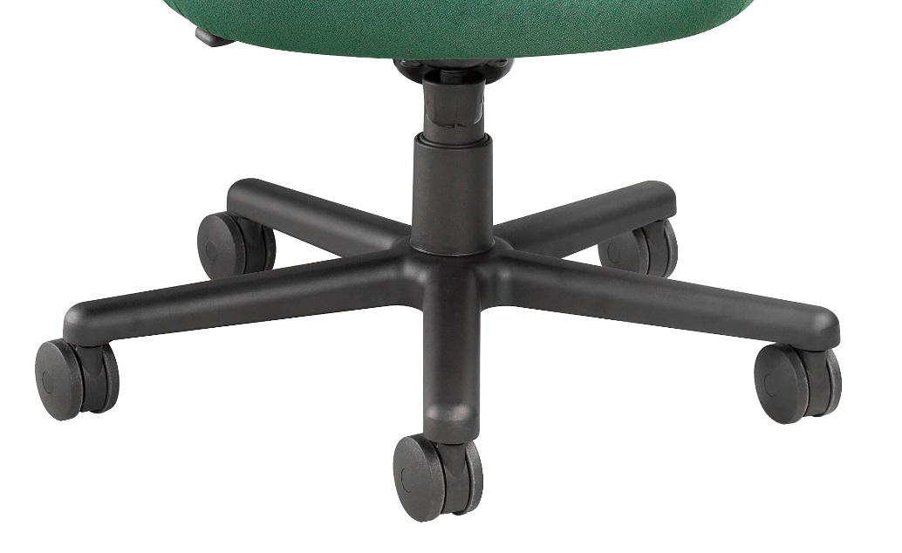
Heavy Duty
pneumatic lift
5 prong heavy duty aluminum base
3” dual wheel
carpet casters

Slide 11
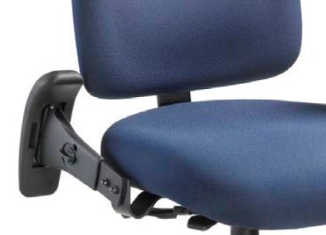
Options
3" soft tile casters
Armless
Fold away arms
Polished Aluminum Base
California fire code #133

Slide 12
Applications
Multi Shift Operations
Law Enforcement
911 Call Center
Fire Halls
Security
Laboratory
Factory
Community Center

Slide 13
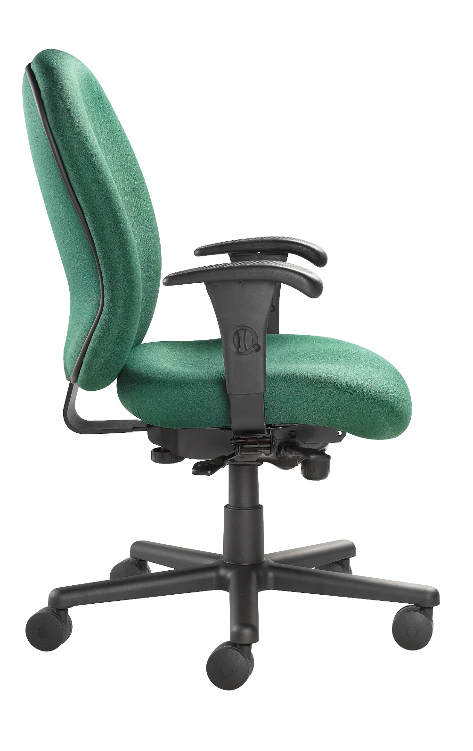
Level 1 e3 Certified
GREENGUARD Children & School and Indoor Air Quality Certified
Nightingale is a 100% waste free facility; powered by Solar & Wind

Slide 14
Rating & Warranty
450 lbs capacity
3 shifts a day: 24/7 usage
Lifetime Limited:
All non-moving metal parts
5 Years: Frame & Parts
2 Years: Upholsteries

Slide 15
Any Questions ?

Slide 16
Mark Francis
Learning & Development Manager
Nightingale University
905.896.3434
800.363.8954
Ext 204
mfrancis@nightingalechairs.com
www.nightingalechairs.com

