Slide 1
Seating Excellence since 1928
This presentation is confidential and is intended only for the individual named. Disclosing, copying, distributing or taking any action in reliance on the contents of this information is strictly prohibited

Slide 2
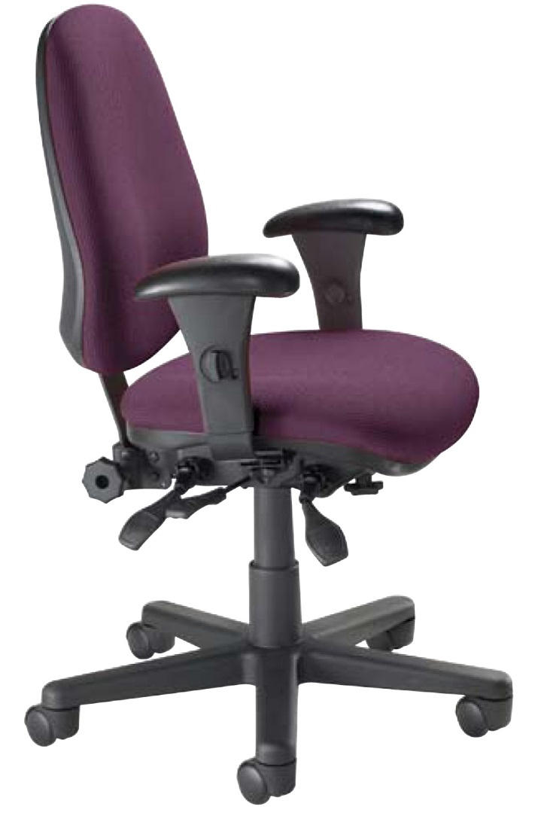
Any Time
All the Time
Accommodates individuals up to 300 pounds for 3 shifts a day; 24/7 usage
Fits any budget and
looks good doing it

Slide 3
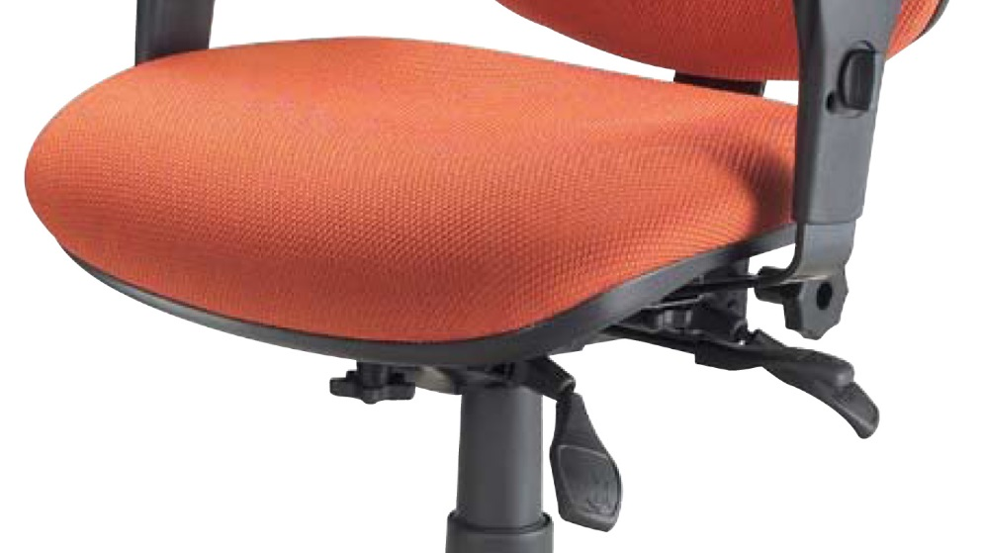
Seat
Swivel tilt mechanism
with infinite position
swivel tilt lock
Pneumatic seat height
Waterfall seat design to reduce muscle fatigue
and improve circulation

Slide 4
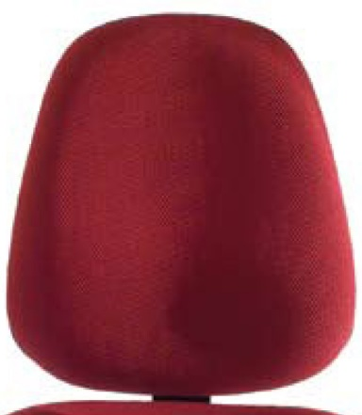
Back
Free float or variable
back angle adjustment
Back height adjustment
and tension control
Built-in lumbar support
Added durability with
heavy duty back post
and polypropylene
outside back and seat shell

Slide 5
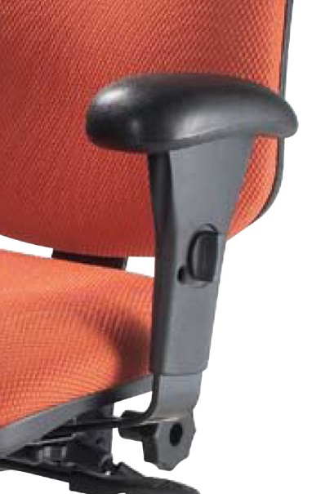
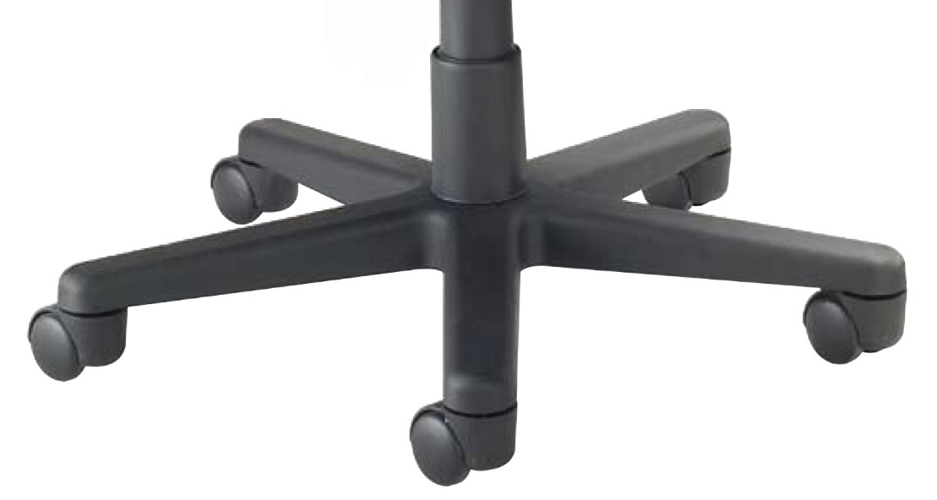
Arm & Base
Heavy duty height and width adjustable arms for
comfort and durability
5 prong heavy
duty nylon base

Slide 6
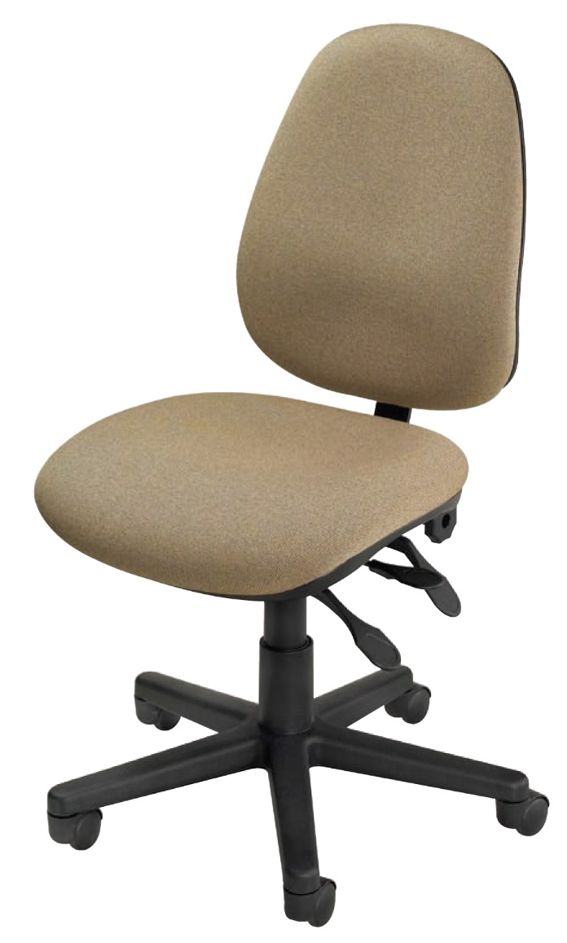
Options
Armless
2"soft tile casters
California Fire Code #133

Slide 7
Applications
Multi Shift Operations
Law Enforcement
911 Call Center
Fire Halls
Security
Factory
Any Space with
Little Space

Slide 8
Level 1 e3 Certified
GREENGUARD Children & School and Indoor Air Quality Certified
Nightingale is a 100% waste free facility; powered by Solar & Wind

Slide 9
Rating & Warranty
Rated for users up to 300 pounds;
3 shifts a day, 24/7 usage
Lifetime Limited: All non-moving metal parts.
5 Years: Frame & Parts
2 Years: Upholsteries

Slide 10
Any Questions ?

Slide 11
Mark Francis
Learning & Development Manager
Nightingale University
905.896.3434
800.363.8954
Ext 204
mfrancis@nightingalechairs.com
www.nightingalechairs.com

