Slide 1
Seating Excellence since 1928
This presentation is confidential and is intended only for the individual named. Disclosing, copying, distributing or taking any action in reliance on the contents of this information is strictly prohibited

Slide 2
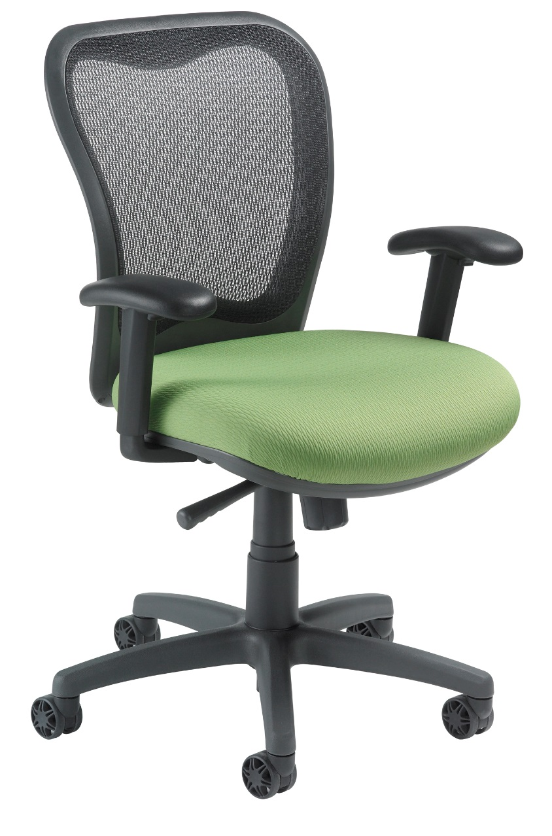
Sometimes Less
is More
Essential ergonomics encompassing the full range of vital support and movement; all incorporated into a smaller chair … but
not less of a chair !
‘ Little XO ‘

Slide 3
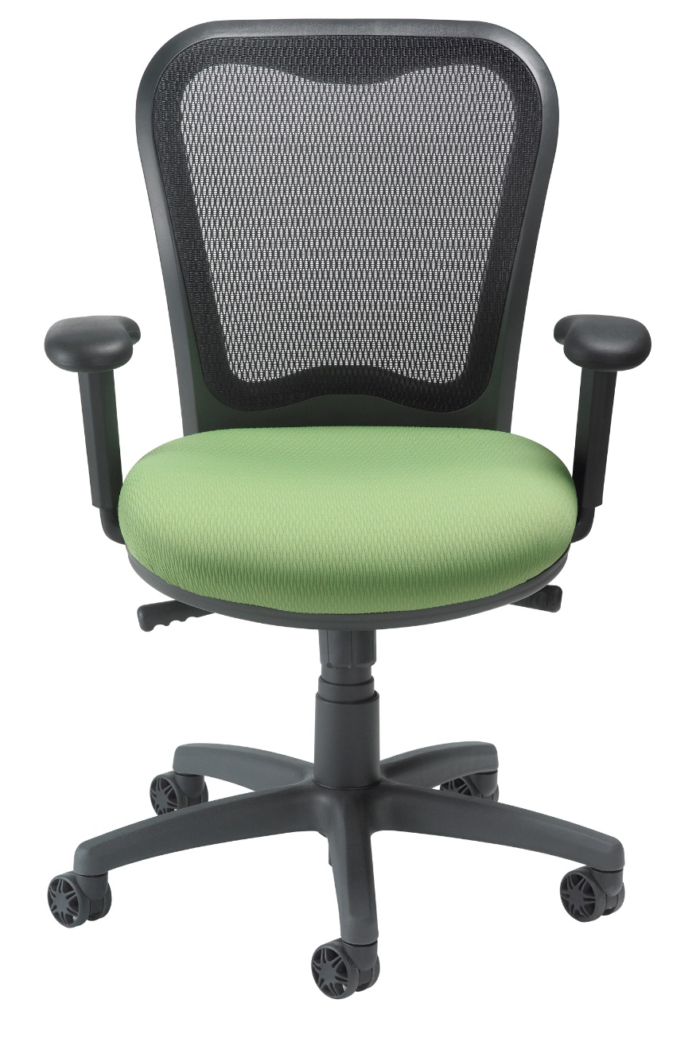
One Chair
Multiple Functions
Perfect for working, meeting or training the LXO™ is the new standard for ergonomic
affordable seating
LXO™ is light weight
and well proportioned

Slide 4
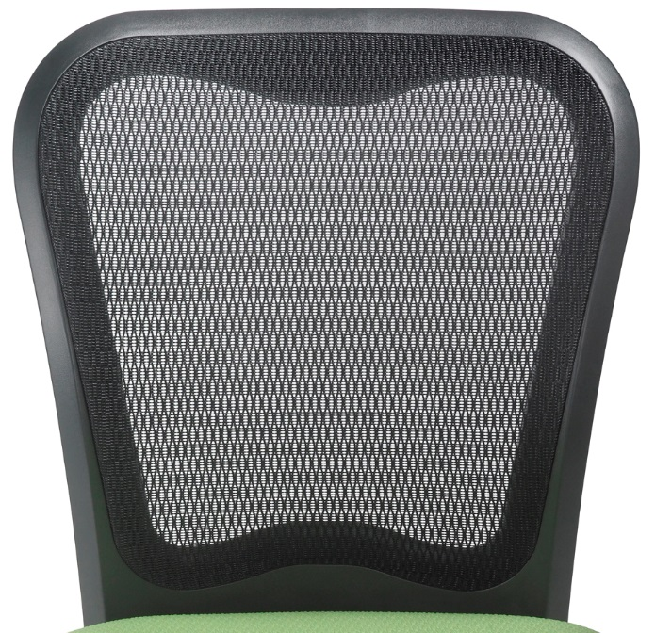
Back
Responsive ABLEX™ patterned weave mesh back provides generous lumbar support while allowing dynamic back movement
Air flows freely through
this breathable mesh
for added comfort in
any environment

Slide 5
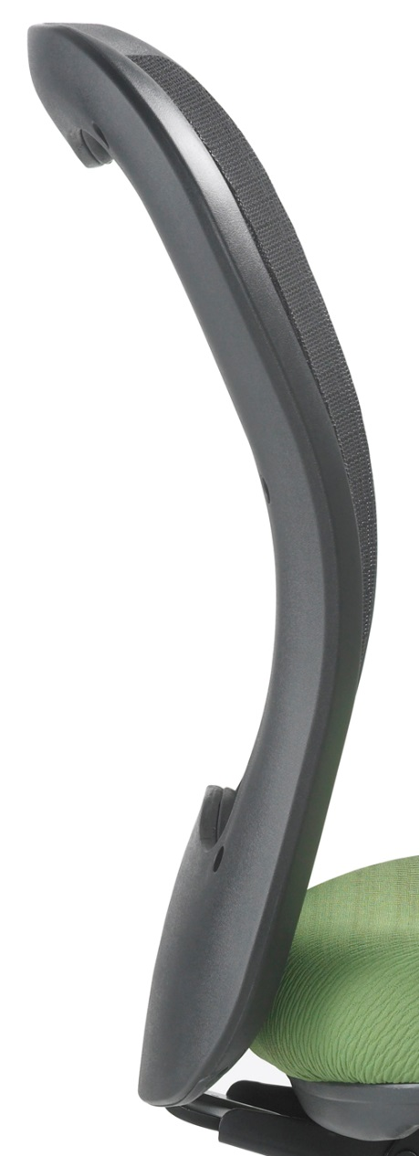
Contoured back design
offers optimal
lumbar support
Pelvis Pocket maintains the natural inward curve of the lower back and stops the automatic, but unhealthy, backward rotation of the user’s pelvis when seated

Slide 6
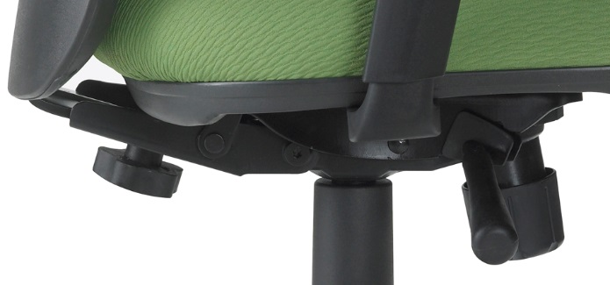
Mech Movements
Synchro Tilt Mechanism,
2:1 ratio, with swivel
3 position tilt-lock
Pneumatic height adjustment
Seat back adjustment
for those requiring
more leg support
Tension control

Slide 7
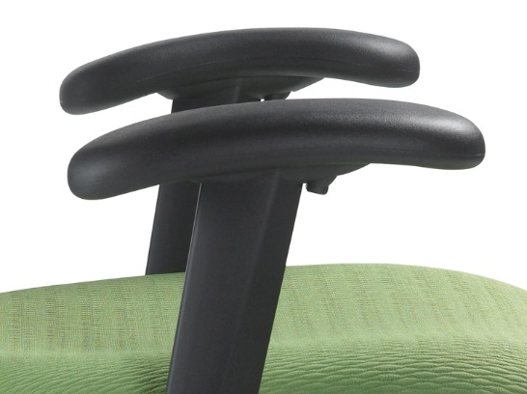
Arm
Easy to use, height adjustable arms with intuitive finger-tip
trigger for individual comfort and support
The arms can be
manually adjusted
for horizontal width

Slide 8
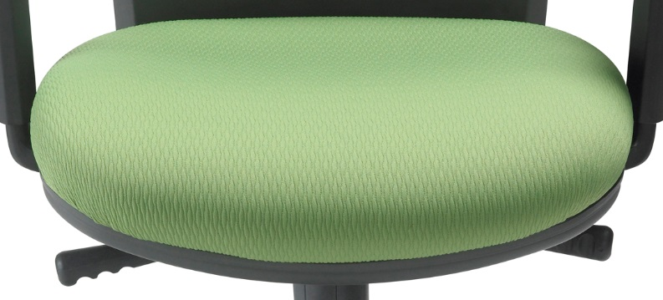
Seat
Energy absorbing ENERSORB™ seat
cushioning reduces
sitting fatigue by minimizing pressure
spots and increasing
blood circulation

Slide 9
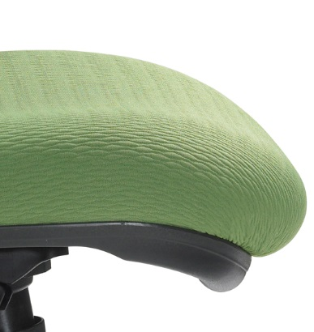
“Waterfall” seat design
that gently slopes away from the legs minimizing pressure on the thighs,
promoting good
posture

Slide 10
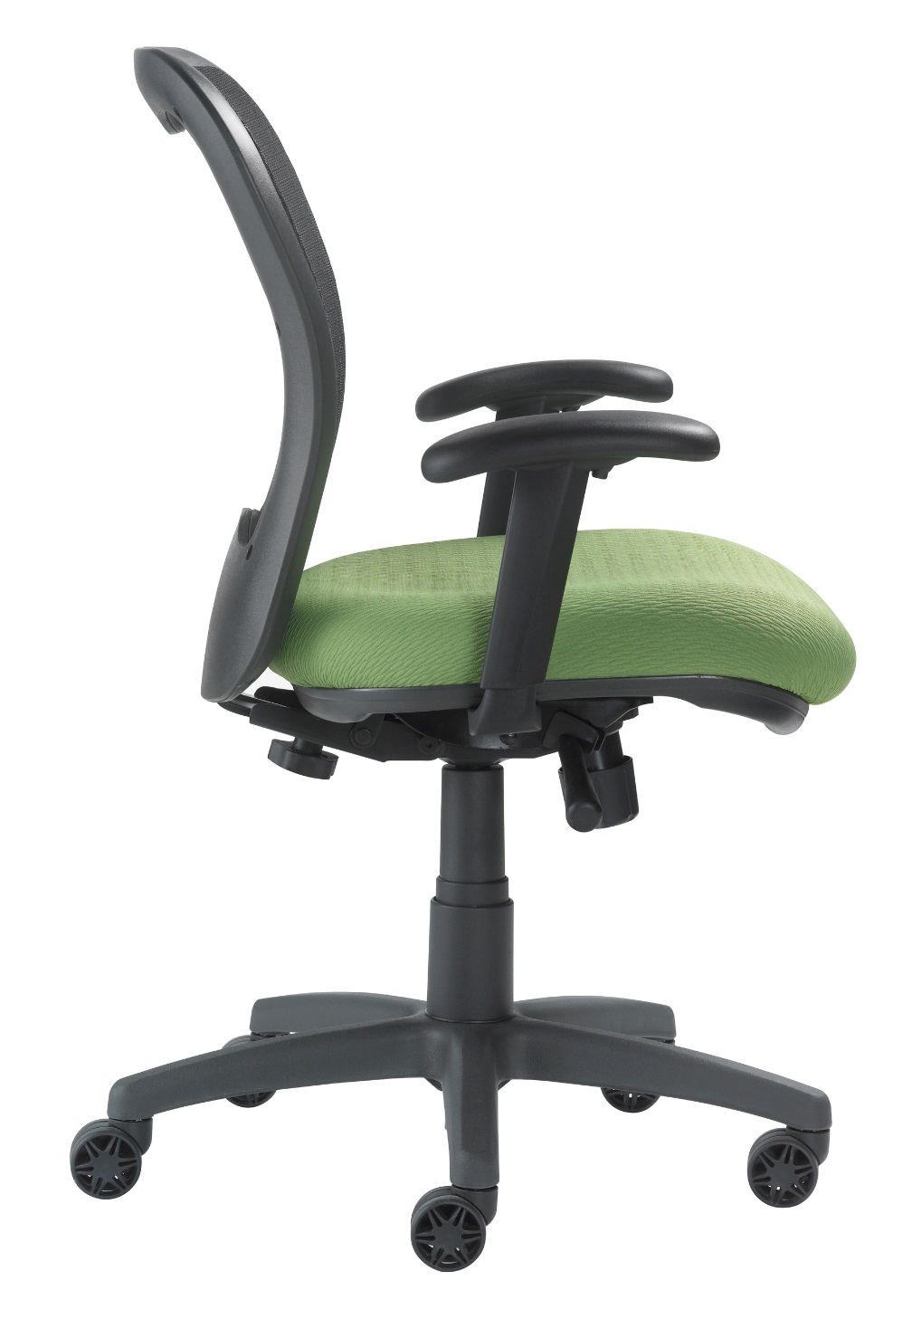
Finish
Frame, arms, base
and trim standard
in graphite
Ultra light
Ultra durable

Slide 11
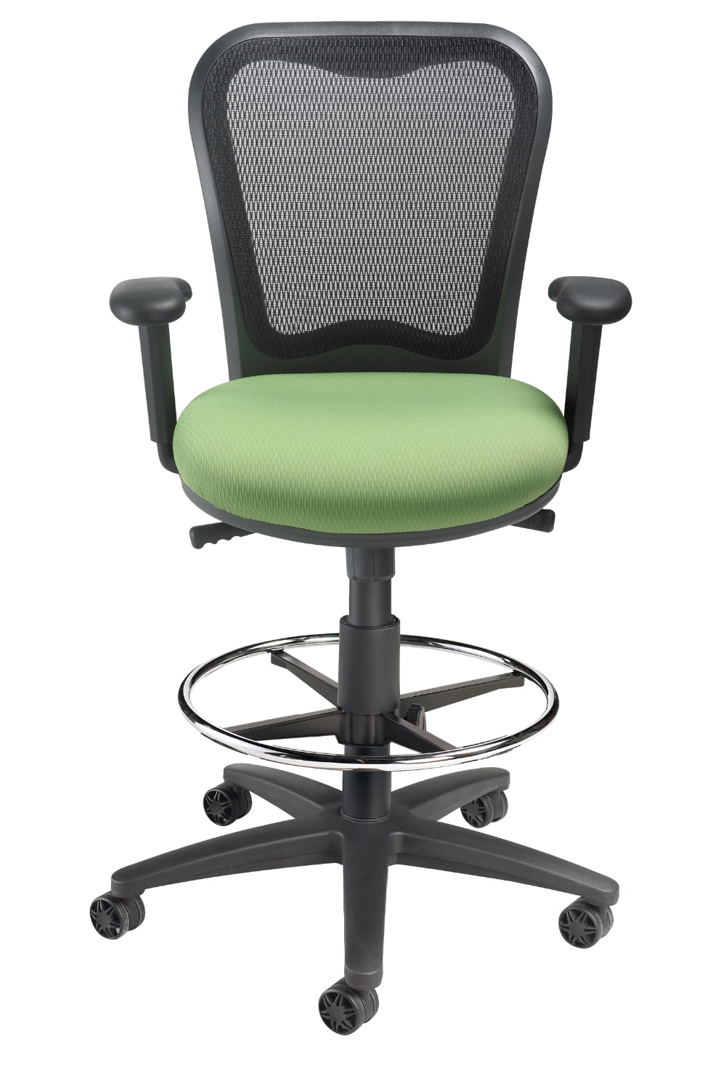
Drafting Stool
Incorporating ABLEX Mesh back support and ENERSORB™ seat cushioning; both of which offer personalized form fitting memory response
Unsurpassed for
multi-user applications
Arm or armless

Slide 12
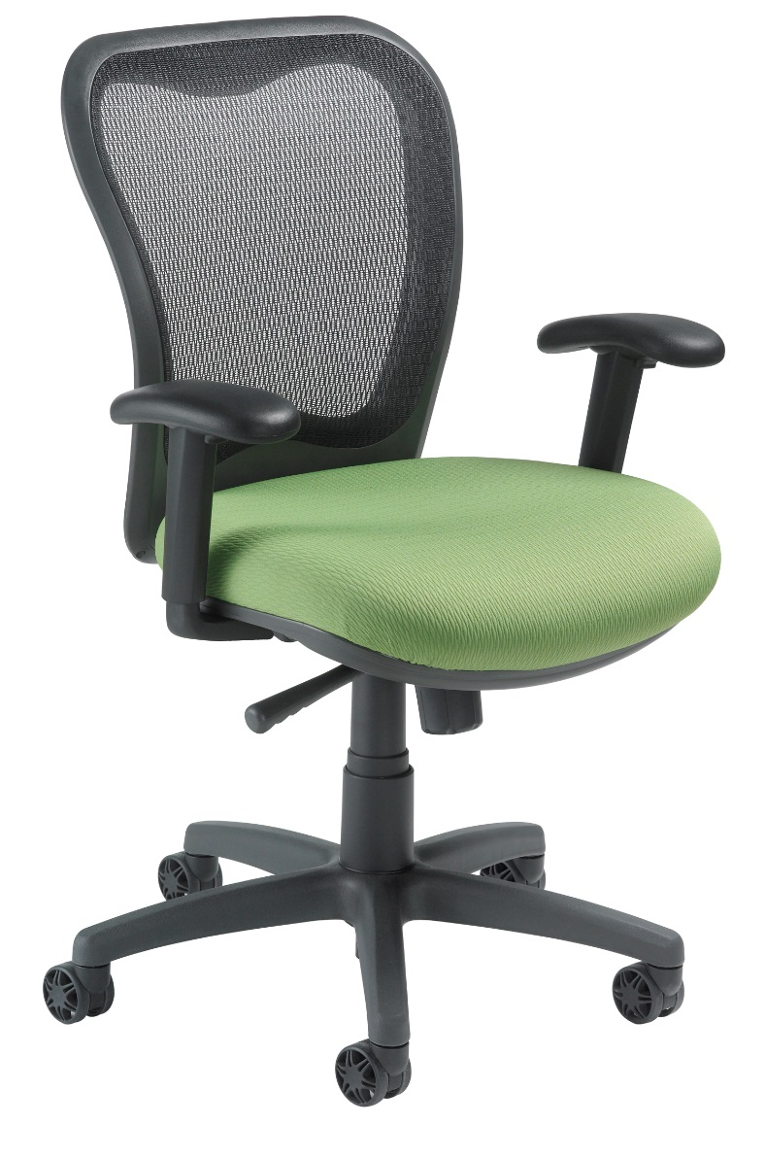
Options
Soft Tile Casters 2”
Self Locking Casters
Polished Aluminum Base
Seat Slider
4 Way Arm Adjustment
3" Carpet Casters
Silver Mesh
Glides
Chrome
California Fire Code #133

Slide 13
Applications
LXO
Task
Boardroom
Ergonomic
Assessment
LXO DS
[Drafting Stool]
Bank teller
Library
Factory

Slide 14
Applications
Budgets
LXO sells, on average,
at 57% less
Than CXO
Smaller Fit

Slide 15
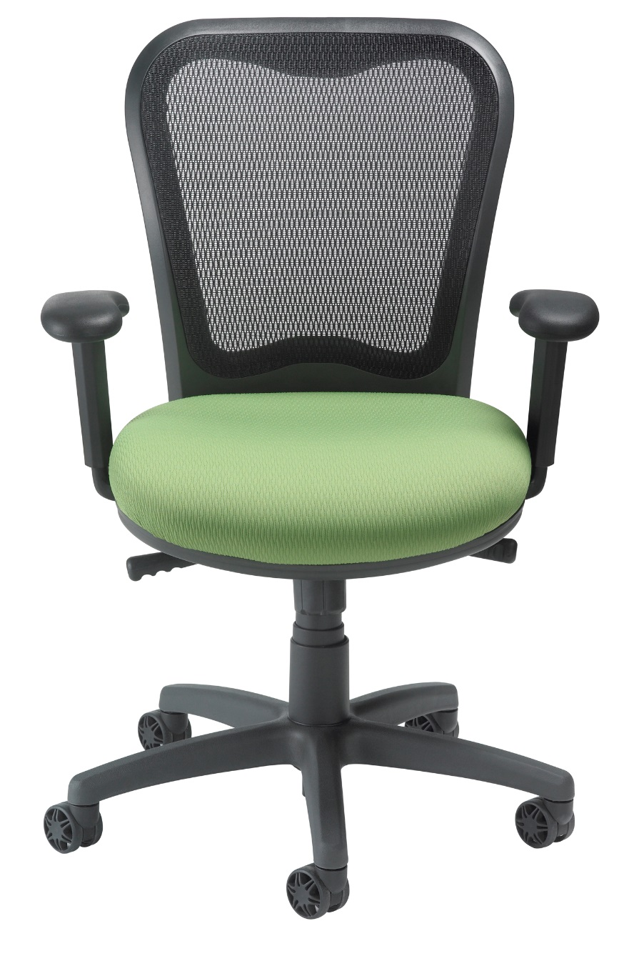
Level 1 e3 Certified
GREENGUARD Children & School and Indoor Air Quality Certified
Nightingale is a 100% waste
free facility; powered by
Solar & Wind

Slide 16
Rating & Warranty
Rated for users up to 300 pounds, for a 40 hour work week
Lifetime Limited: All non-moving metal parts.
10 Years: Frame & Parts
5 Years: Upholsteries

Slide 17
Any Questions ?

Slide 18
Mark Francis
Learning & Development Manager
Nightingale University
905.896.3434
800.363.8954
Ext 204
mfrancis@nightingalechairs.com
www.nightingalechairs.com

