Slide 1
Seating Excellence since 1928
This presentation is confidential and is intended only for the individual named. Disclosing, copying, distributing or taking any action in reliance on the contents of this information is strictly prohibited

Slide 2
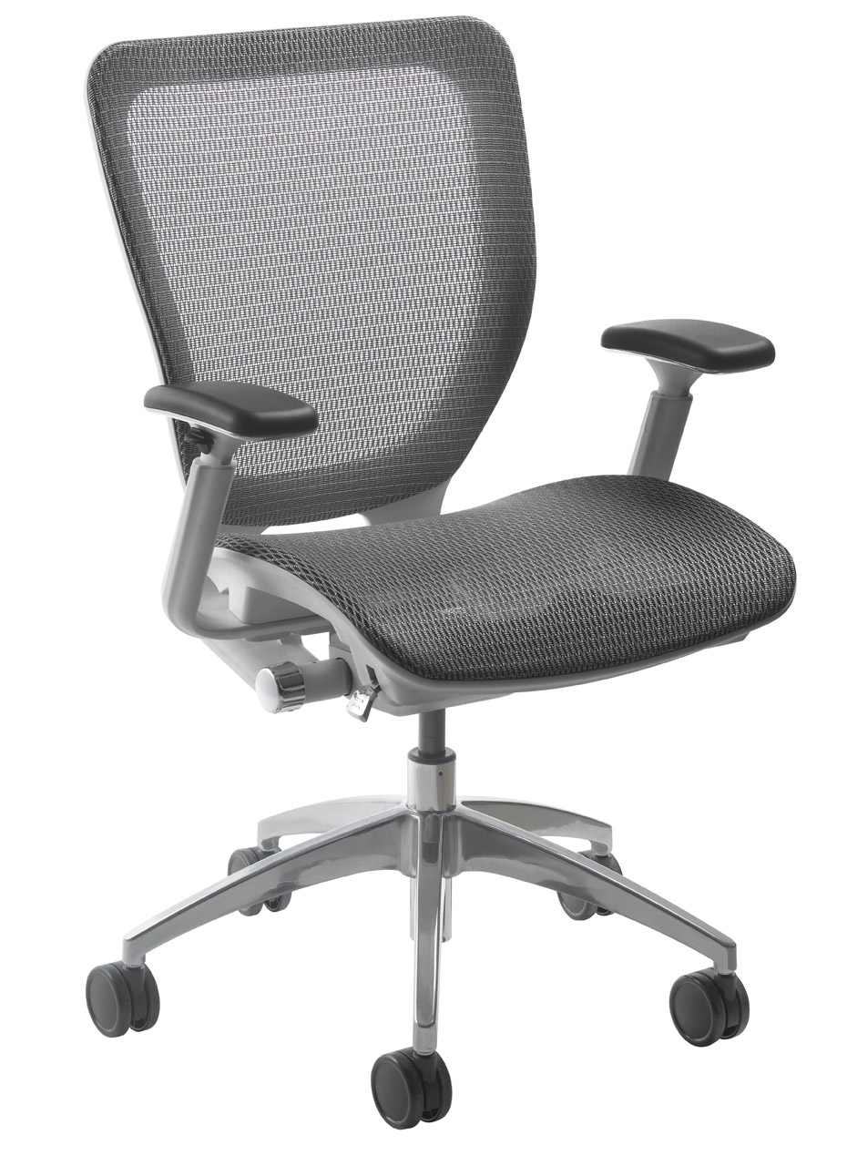
You Never get a Second Chance to make a
First Impression
Don’t Need One …
Sleek profile with Nightingale’s distinctive signature of ultra-comfort and ergonomic support engineered into
every movement

Slide 3
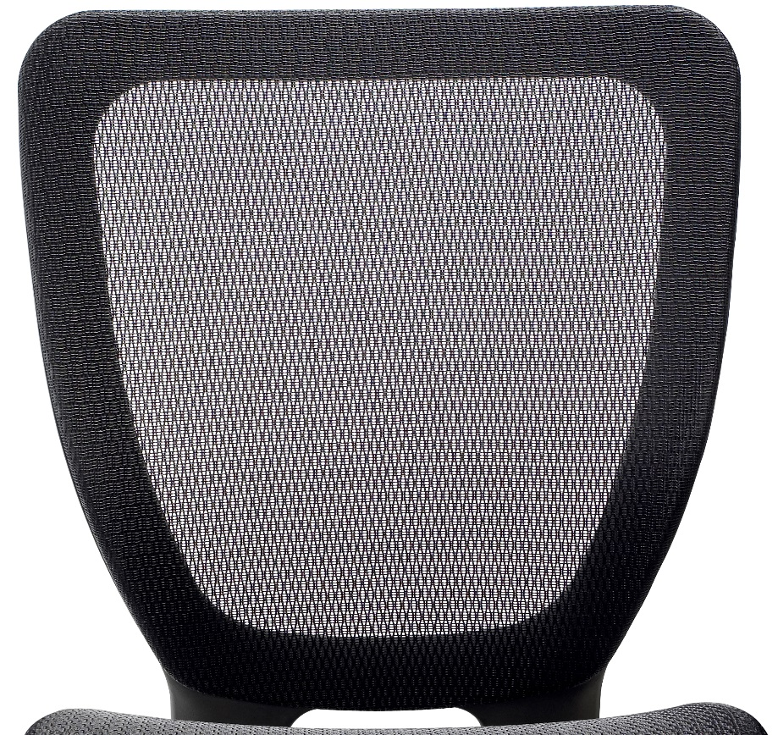
Back
Translucent ABLEX™ patterned weave mesh back and seat provides generous lumbar and
pelvic support while promoting dynamic
back and seat
movement

Slide 4
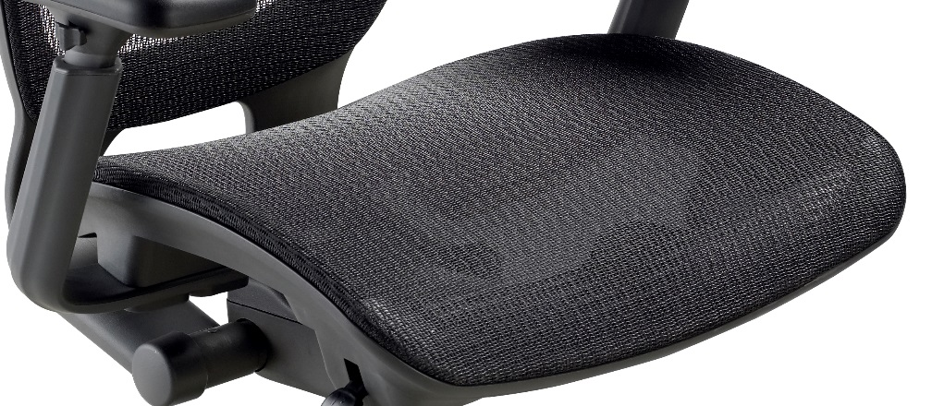
Standard Mesh Seat
Extra wide seat
pan maximizes the
sitting experience
with full seat and
leg support
Translucent ABLEX™ patterned weave
mesh, with memory
Smooth across seat;
no plastic ridges

Slide 5
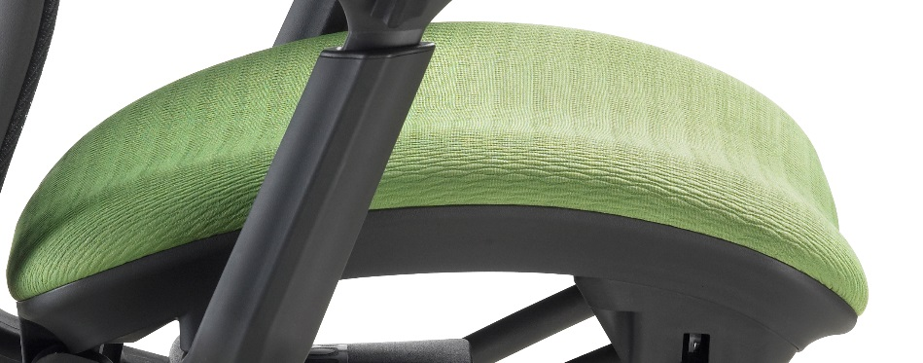
Optional Fabric Seat
Energy absorbing ENERSORB™ seat cushioning conforms to your body and disperses your weight ergonomically to improve blood circulation and relieves pressure
points
Contoured waterfall
seat design helps to
reduce sitting fatigue
and promotes good posture

Slide 6
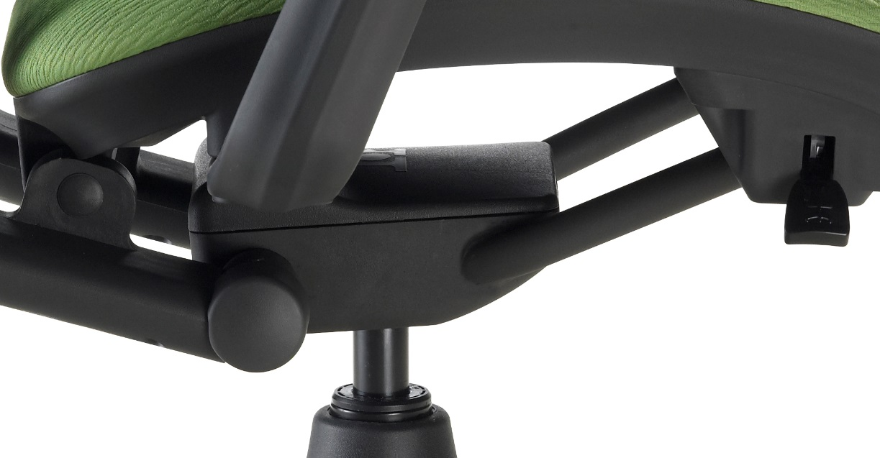
Mech
Synchronous knee-tilt torsion glide
Mechanism
Direct cable
activated controls
Preset tension
Positive back
lock release
Pneumatic seat
height adjustment

Slide 7
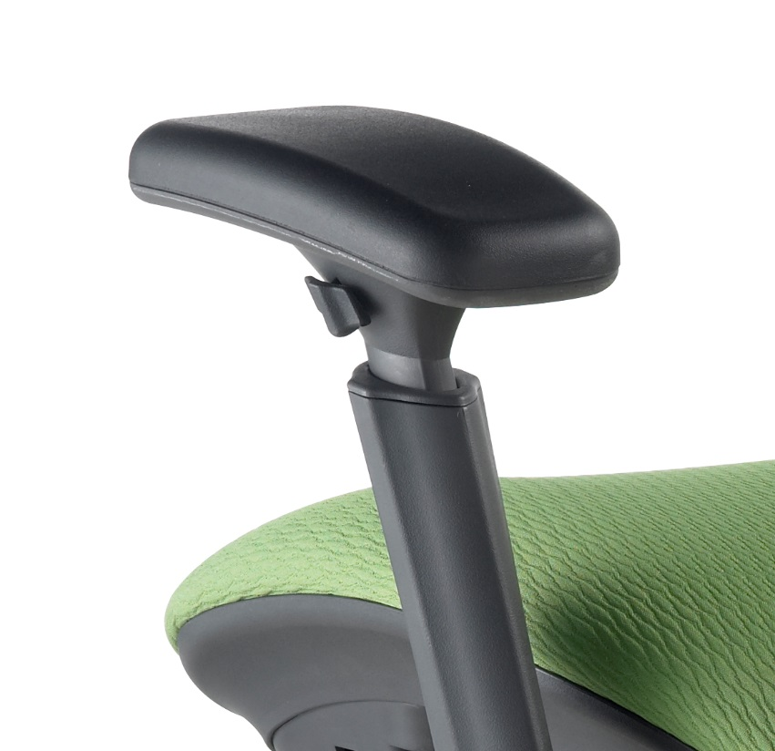
Arm
Easy to use height adjustable arms with lockable, pivoting, polyurethane arm pads

Slide 8
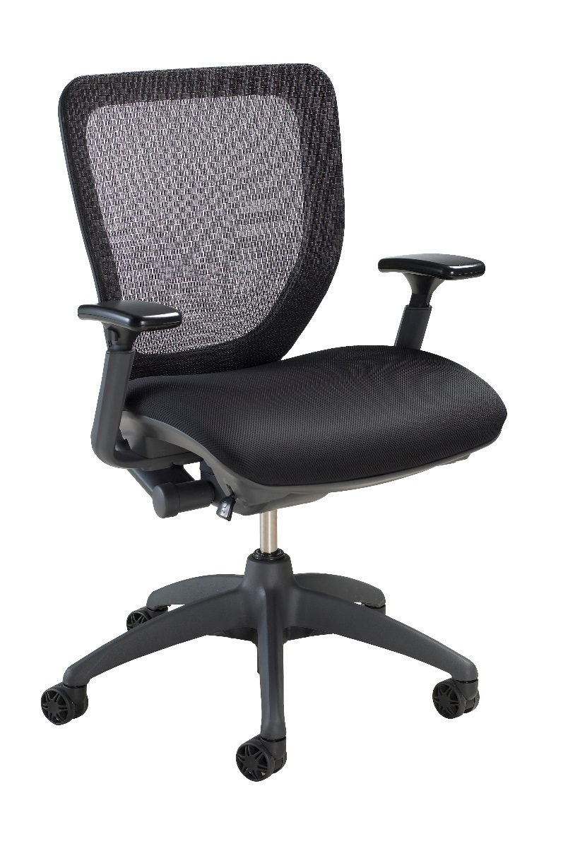
Finish
Frame finished in
graphite; enhancing
the overall visual with
a contemporary finish

Slide 9
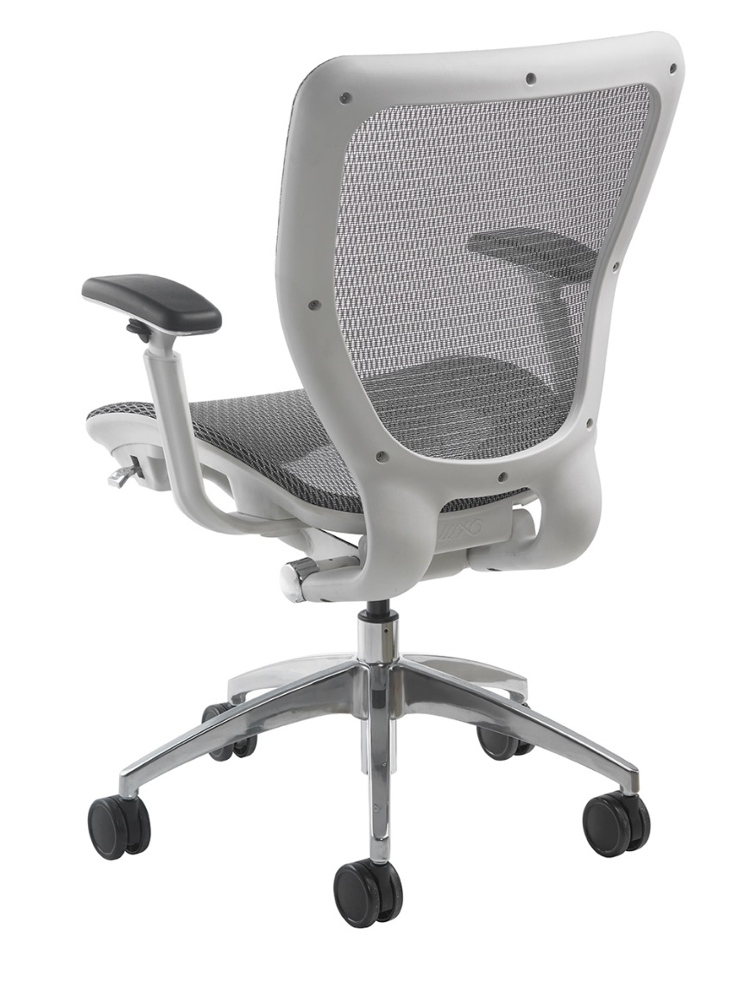
Options
Silver Mesh Back + Seat
Soft Tile Casters 2“
Chrome Finish
California Fire Code #133
White Frame WH (Standard with silver mesh and polished
aluminum base)
3" Carpet Casters

Slide 10
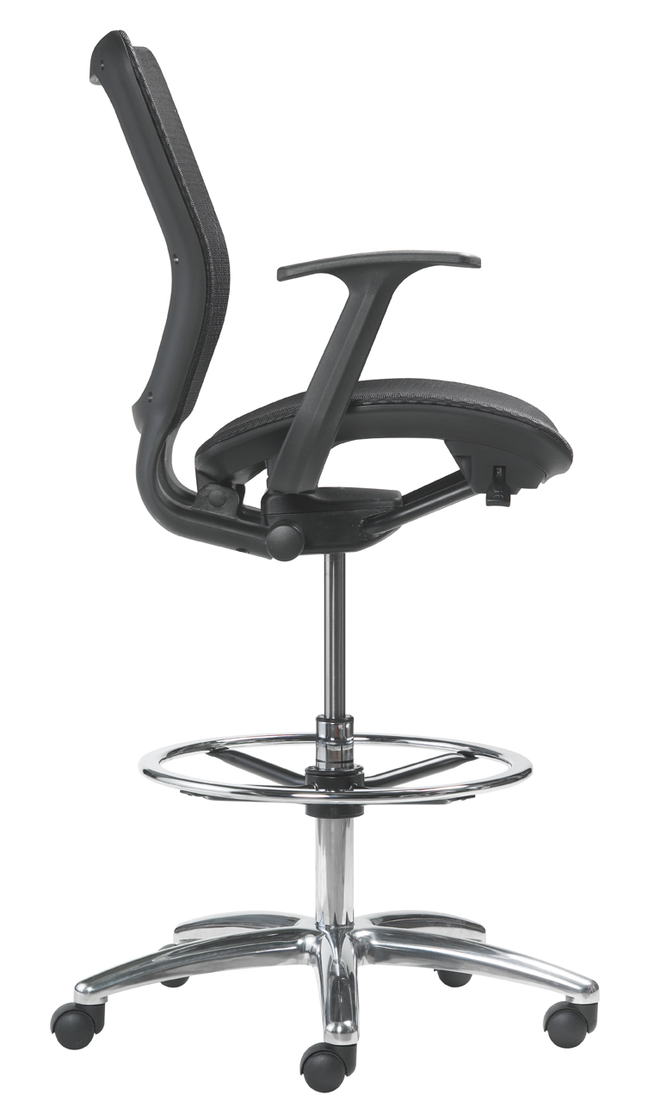
Drafting Stool
Seat height
of 24"-34"

Slide 11
Applications
Aeron comparable
Task
Boardroom
Standards
Ergonomic Assessment
Drafting Stool :
Bank teller
Library
Factory

Slide 12
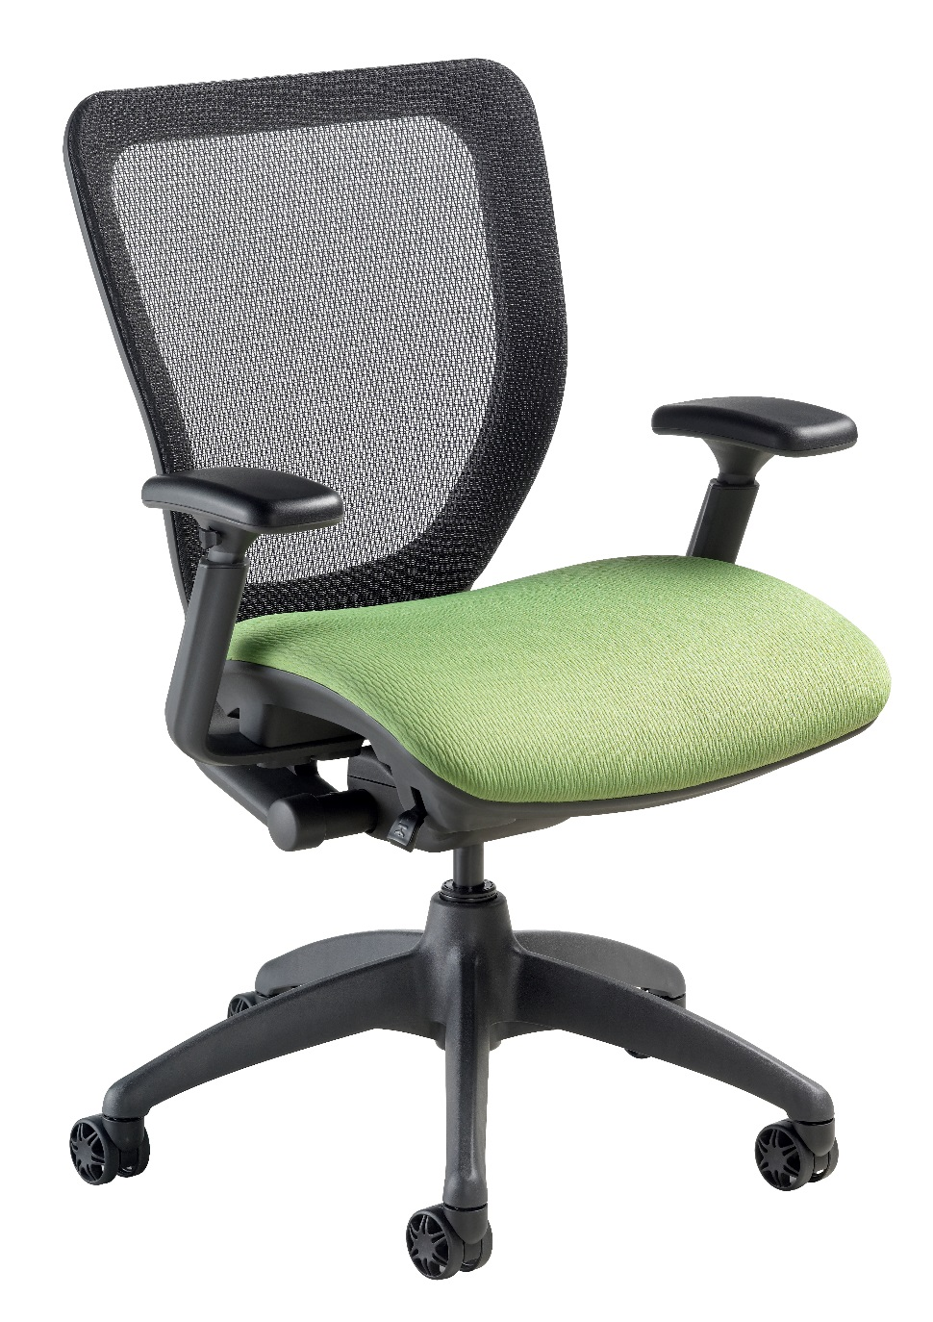
Level 1 e3 Certified
GREENGUARD Children & School and Indoor Air Quality Certified
Nightingale is a 100% waste
free facility; powered by
Solar & Wind

Slide 13
Rating & Warranty
Rated for users up to 300 pounds, for a 40 hour work week
Lifetime Limited: All non-moving metal parts.
10 Years: Frame & Parts
5 Years: Upholsteries

Slide 14
Any Questions ?

Slide 15
Mark Francis
Learning & Development Manager
Nightingale University
905.896.3434
800.363.8954
Ext 204
mfrancis@nightingalechairs.com
www.nightingalechairs.com

