Slide 1
Seating Excellence since 1928
This presentation is confidential and is intended only for the individual named. Disclosing, copying, distributing or taking any action in reliance on the contents of this information is strictly prohibited

Slide 2
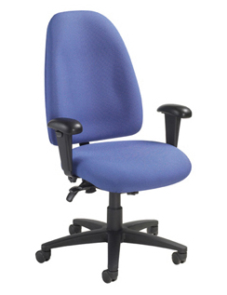
Engaging Aesthetics make it Easy on the Eyes
Fingertip Adjustments make it Easy to Use
Attractive multi-task series that is durable and offers
outstanding value
Easy to use ergonomic adjustments

Slide 3
Applications
Multi Task
Multi Users
Standardized to specific adjustments required by Ergonomic Assessment Teams at numerous State Institutions throughout
the country

Slide 4
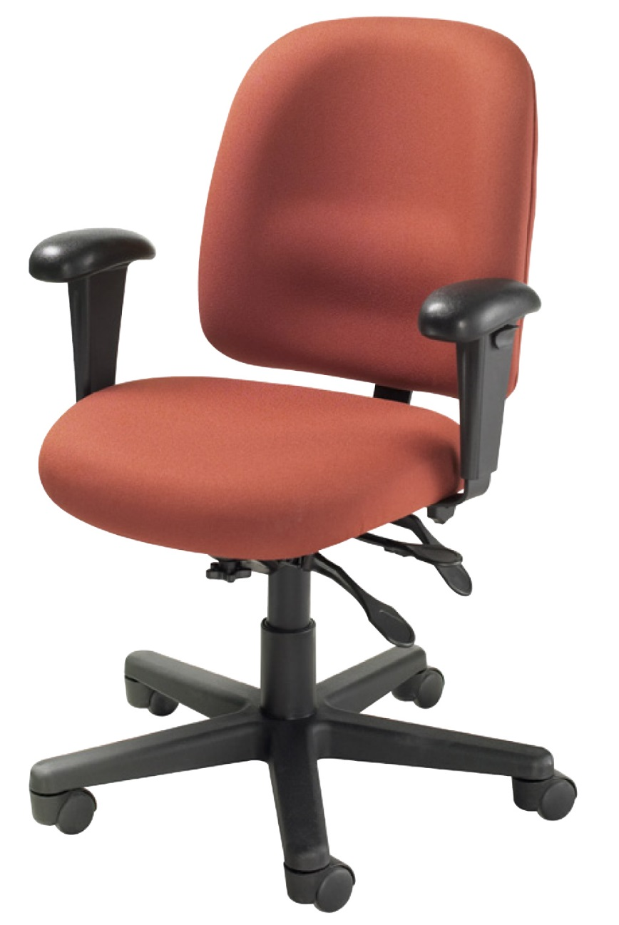
Standard
Swivel-tilt mechanism (3200D, 3200, 3207)
Swivel mechanism (3207DS) with articulating seat
and back
Infinite position swivel
tilt lock
Back angle
adjustment

Slide 5
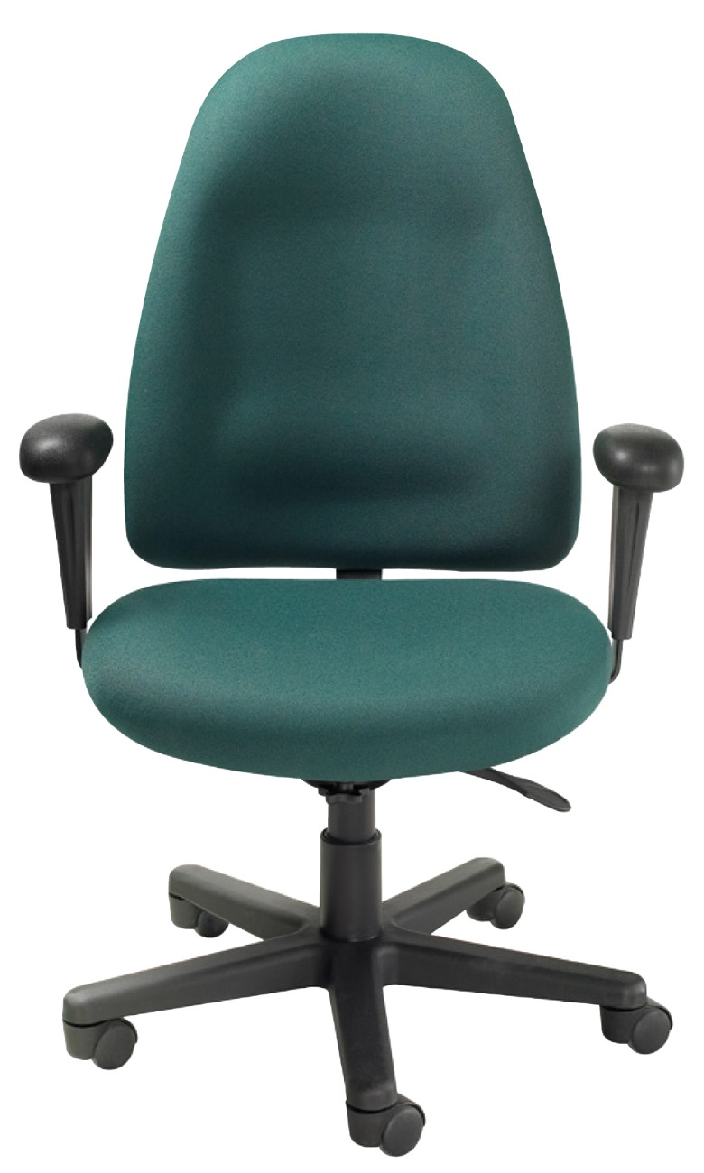
Standard
Pneumatic height adjustment
6º forward tilt
Back height adjustment
Tension control
Waterfall seat design to help reduce muscle fatigue

Slide 6
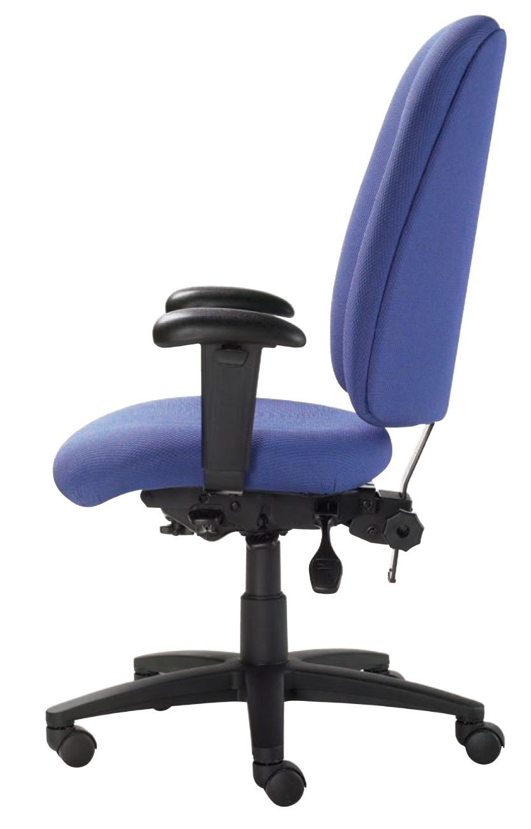
Standard
High density seat
and back foam
Wood seat and back contoured for lateral support and comfort
5 prong heavy duty
nylon base
ANSI/BIFMA

Slide 7
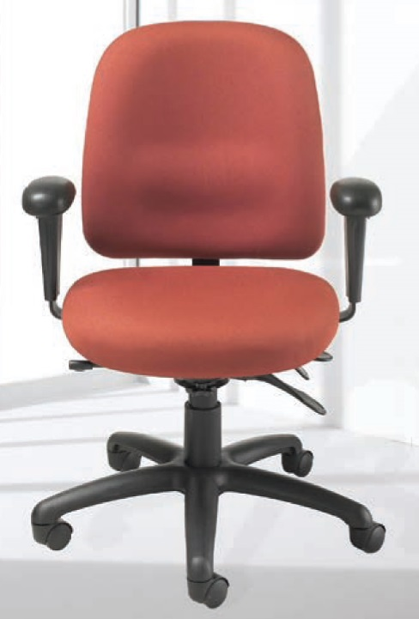
Options
Seat Sliding Mechanism 3200D, 3200, 3207
ENERSORB™
Width and Height Adjustable Arm w/Polyurethane Tear
Drop Arm Pad
3200D, 3200

Slide 8
Options
Soft Tile Casters 2"
California Fire Code #133
3" Carpet Casters

Slide 9
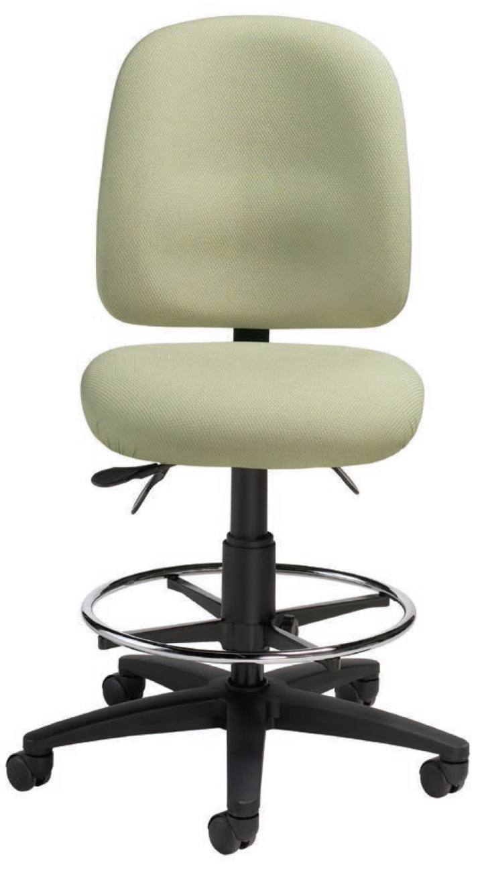
3207DS
Swivel mechanism
Pneumatic height adjustment
Back height adjustment
Adjustable foot ring

Slide 10
Available for
Multi Applications
3200D High Back Task
3200 Mid Back Task
3207 Mid Back
Task Armless
3207DS Armless
Drafting Stool

Slide 11
Rating & Warranty
Rated for users up to 250 pounds, for a 40 hour work week
Lifetime Limited: All non-moving metal parts.
10 Years: Frame & Parts
5 Years: Upholsteries

Slide 12
Level 1 e3 Certified
GREENGUARD Children & School and Indoor Air Quality Certified
Nightingale is a 100% waste
free facility; powered by
Solar & Wind

Slide 13
Mark Francis
Learning & Development Manager
Nightingale University
905.896.3434
800.363.8954
Ext 204
mfrancis@nightingalechairs.com
www.nightingalechairs.com

